Slide 1
Durga Mahavidyalaya Raipur
27 CG Bn NCC Raipur
2021-22

Slide 2
Total Enrolled Cadet : 54
Activity Name | Total Cadet Participated | Date
Rally on Worlds AIDS Day | 41 | 10 Dec. 2021
Poster Making competition on Worlds Aids Day | 23 | 10 Dec. 2021
Inter College and inter School Quiz Competition on Vijay Diwas | 95(Cadets of different School and College) | 17 Dec. 2021
Tree Plantation | 16 | 7 June 2022

Slide 3
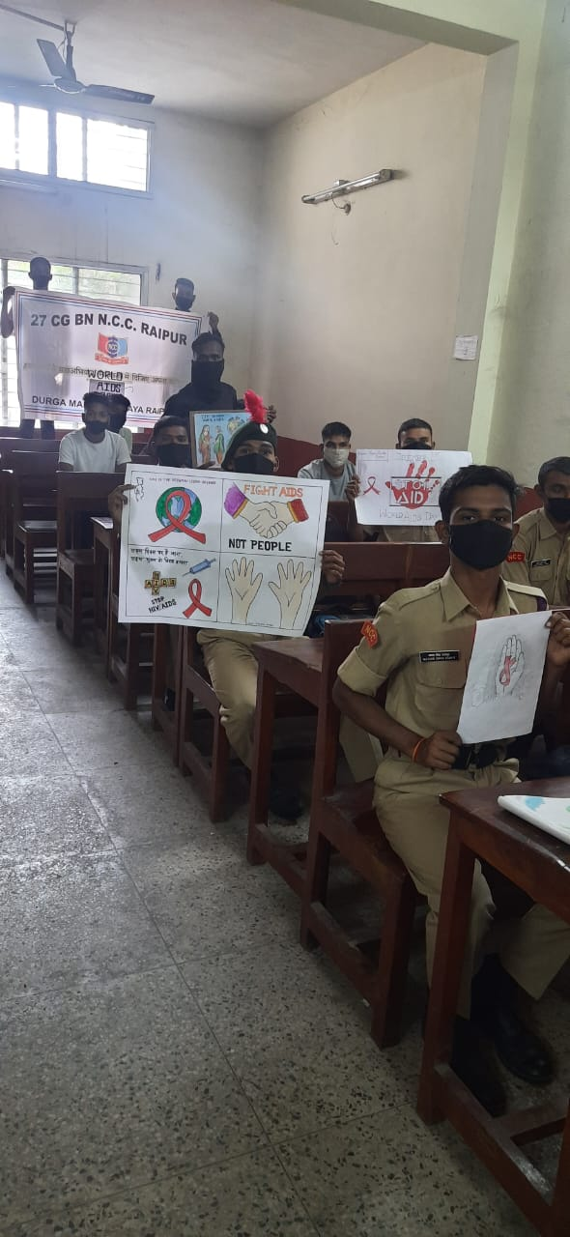
Poster Making competition on Worlds Aids Day
10 Dec. 2021

Slide 4
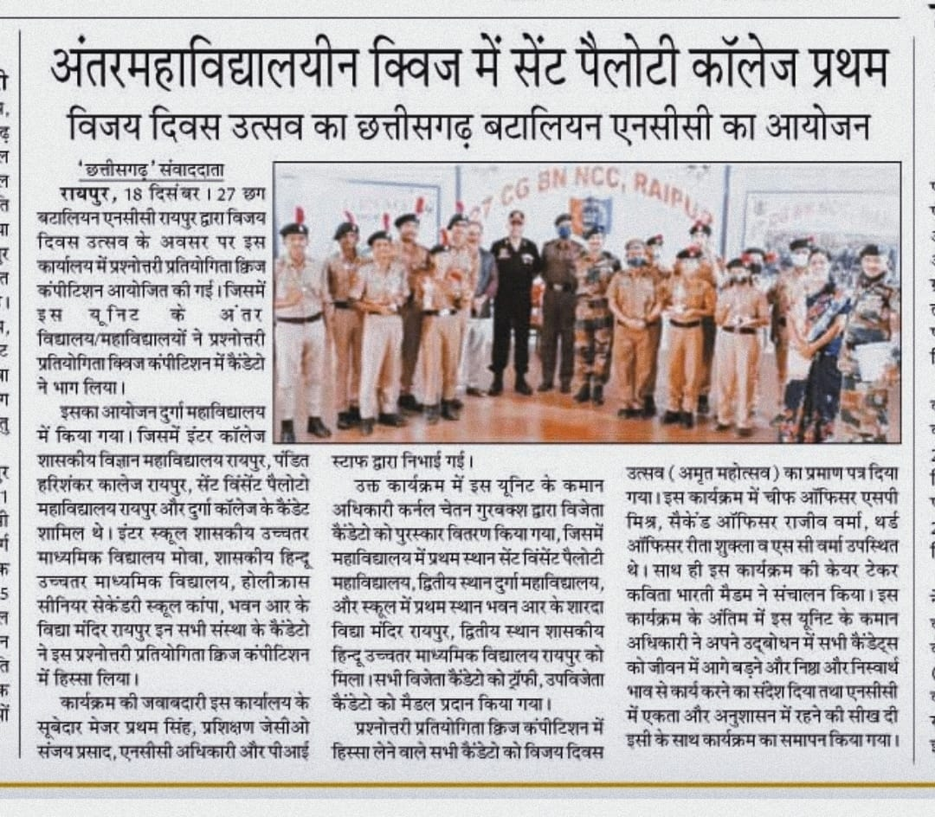
Inter College and inter School Quiz Competition on Vijay Diwas
17 Dec. 2021

Slide 5
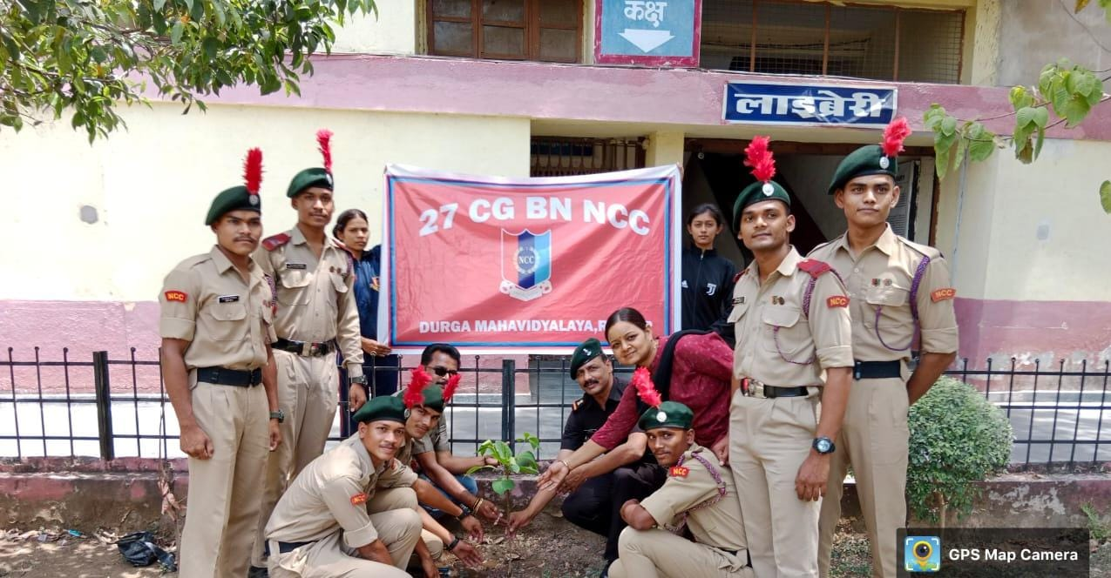
Tree Plantation
7 June 2022

Slide 6
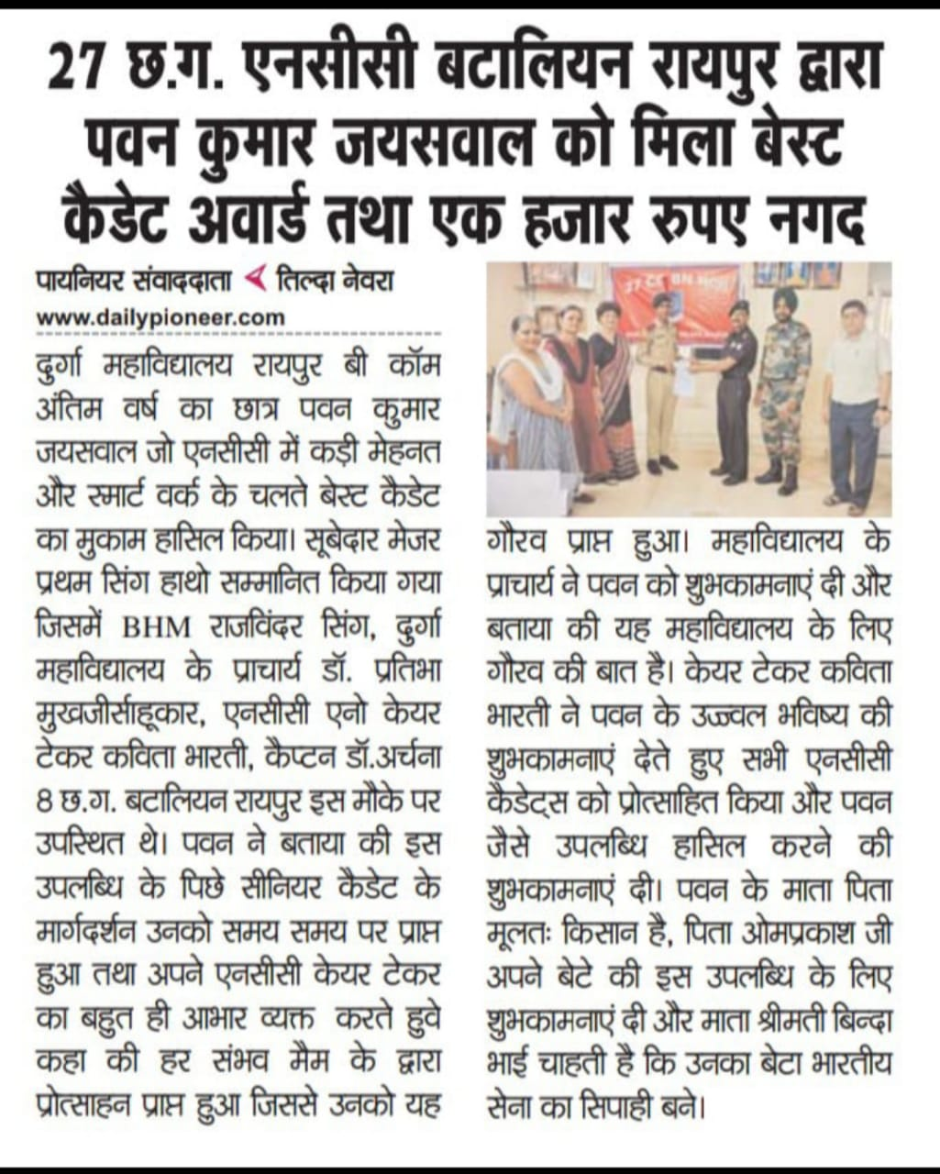
Best Cadet Award
SUO Pawan Jaiswal

