Slide 1

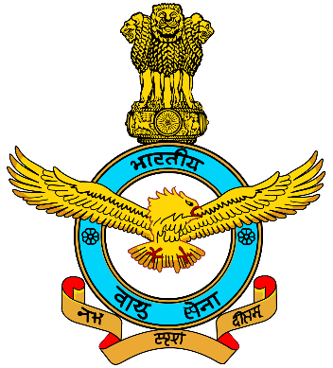
AIR WING NCC (2021-22)
Activities of Cadets of Durga College

Slide 2

OUR POWER
YEAR | SDs (boys) | SWs (girls) | TOTAL
3RD YEAR | 18 | 17 | 35
2ND YEAR | 3 | 25 | 27
1ST YEAR | 13 | 24 | 37
GRAND TOTAL | 34 | 65 | 100

Slide 3

OUR RESULTS
100% Cadets cleared b-certificate exam in 2021-22.
85.71% Cadets cleared c-certificate exam in 2021-22.

Slide 4
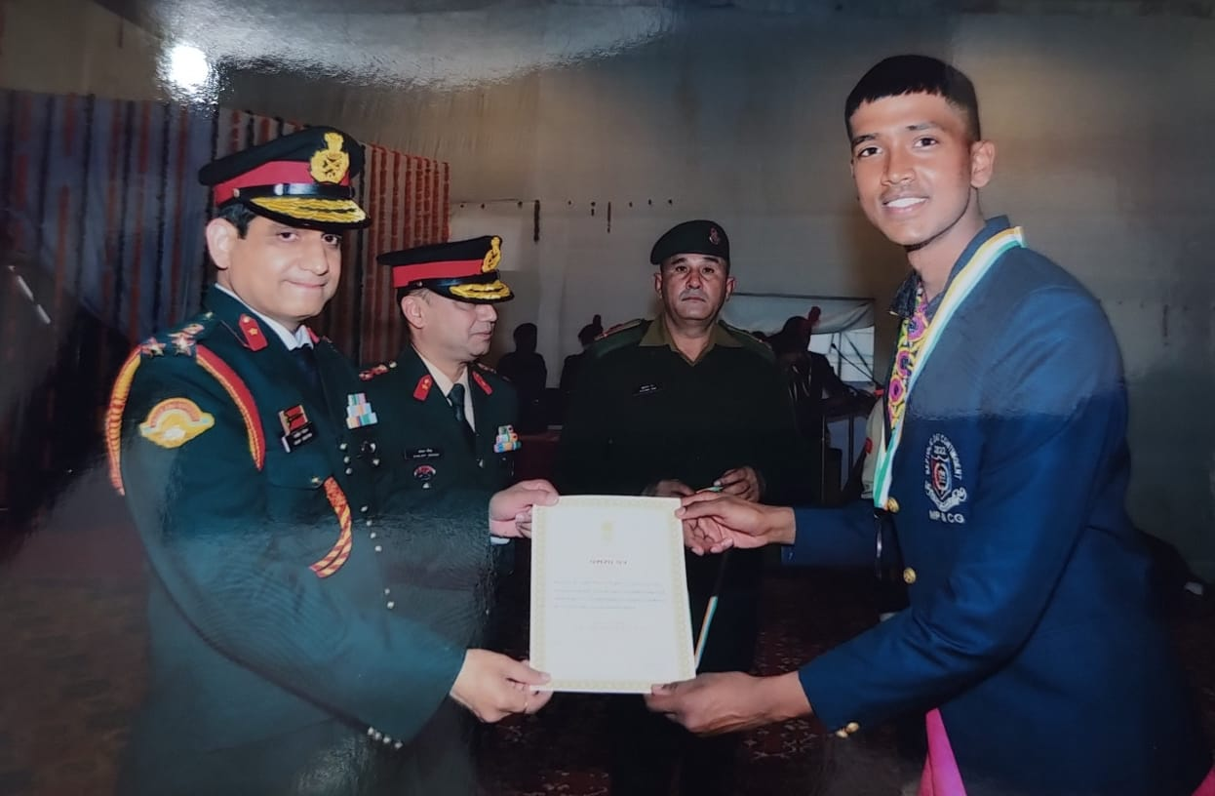
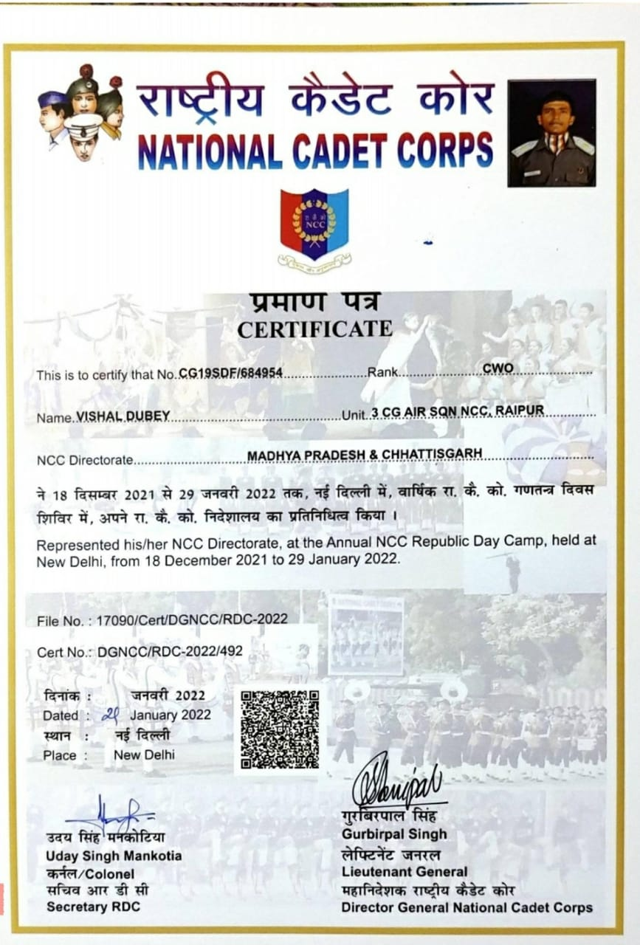
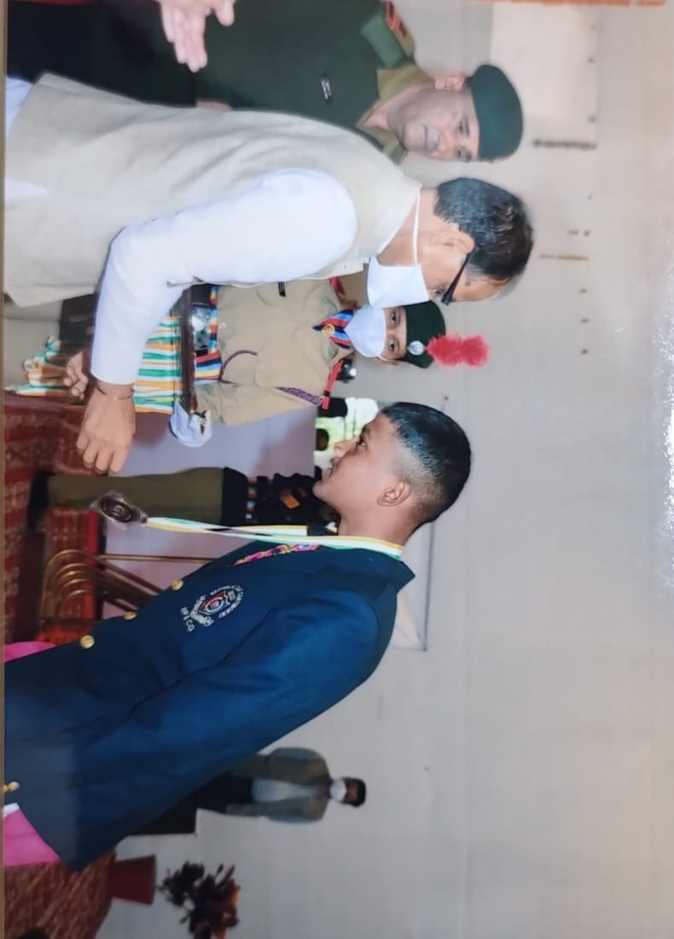
CWO Vishal Dubey of B.Com (Final) attended Republic Day parade in NEW DELHI 0n January 2022

Slide 5
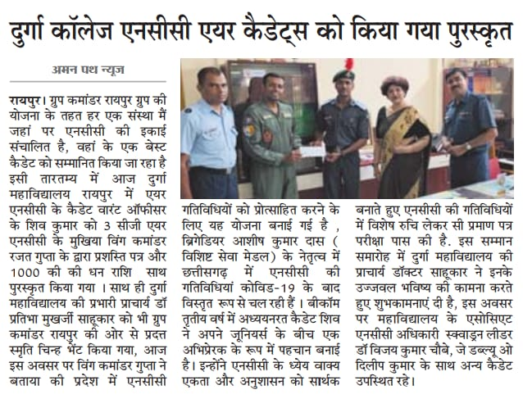
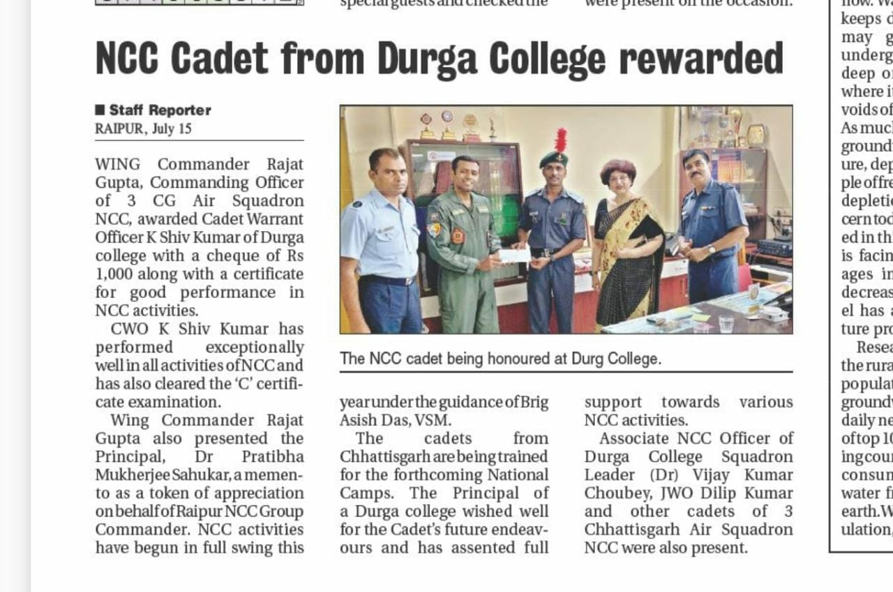
CUO K Shiv Kumar of B.A(Final) was rewarded for his exceptional performance

Slide 6
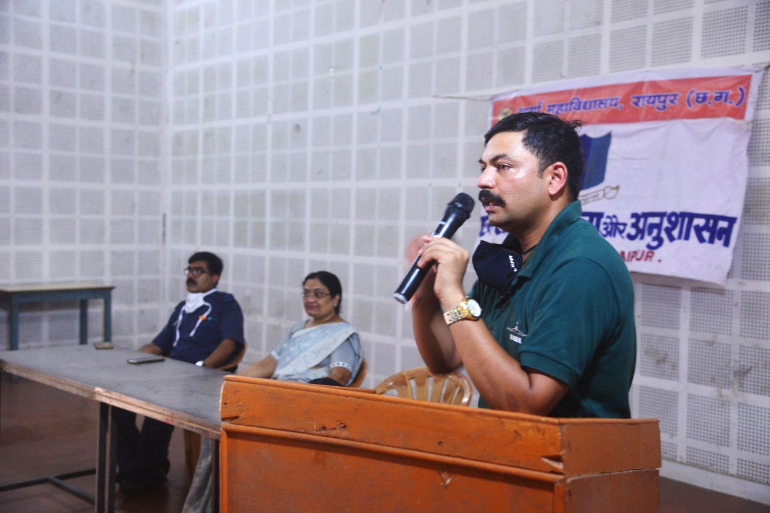
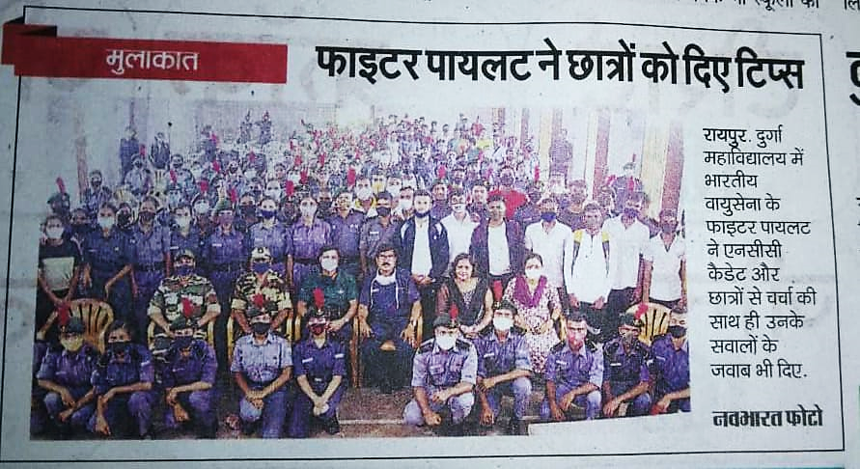
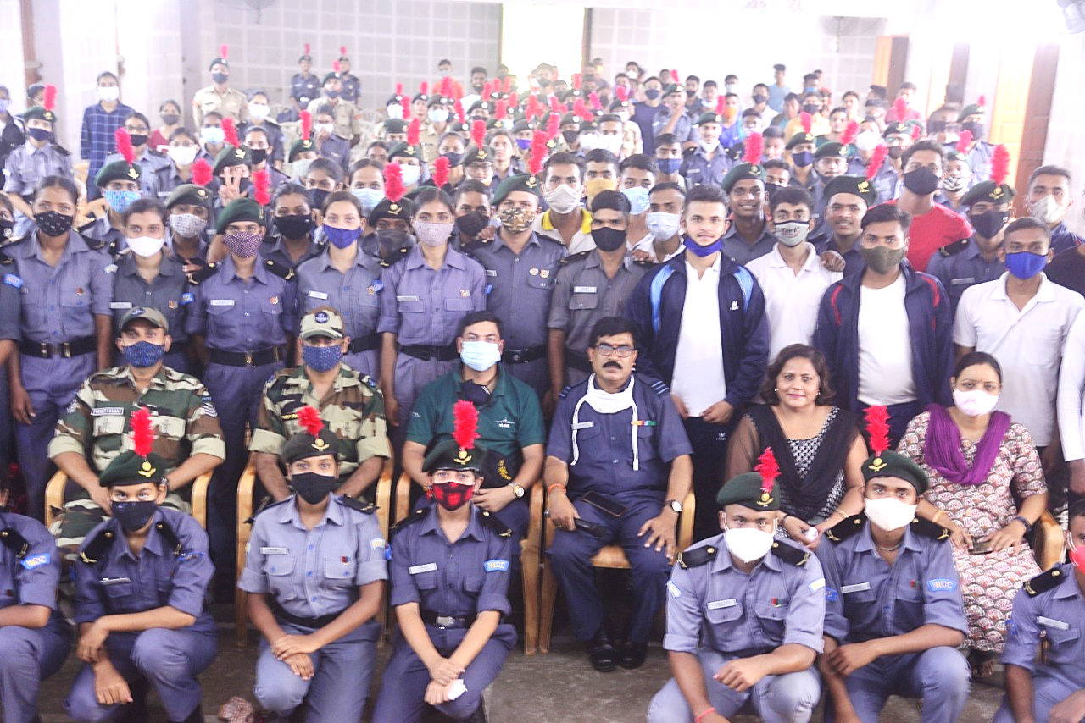
Ex Cadet Sqn Ldr Vivek Sahu briefed the cadets of Durga College on 9th October 2021

Slide 7
Social & other ACTIVITIES DONE BY OUR CADETS

Slide 8
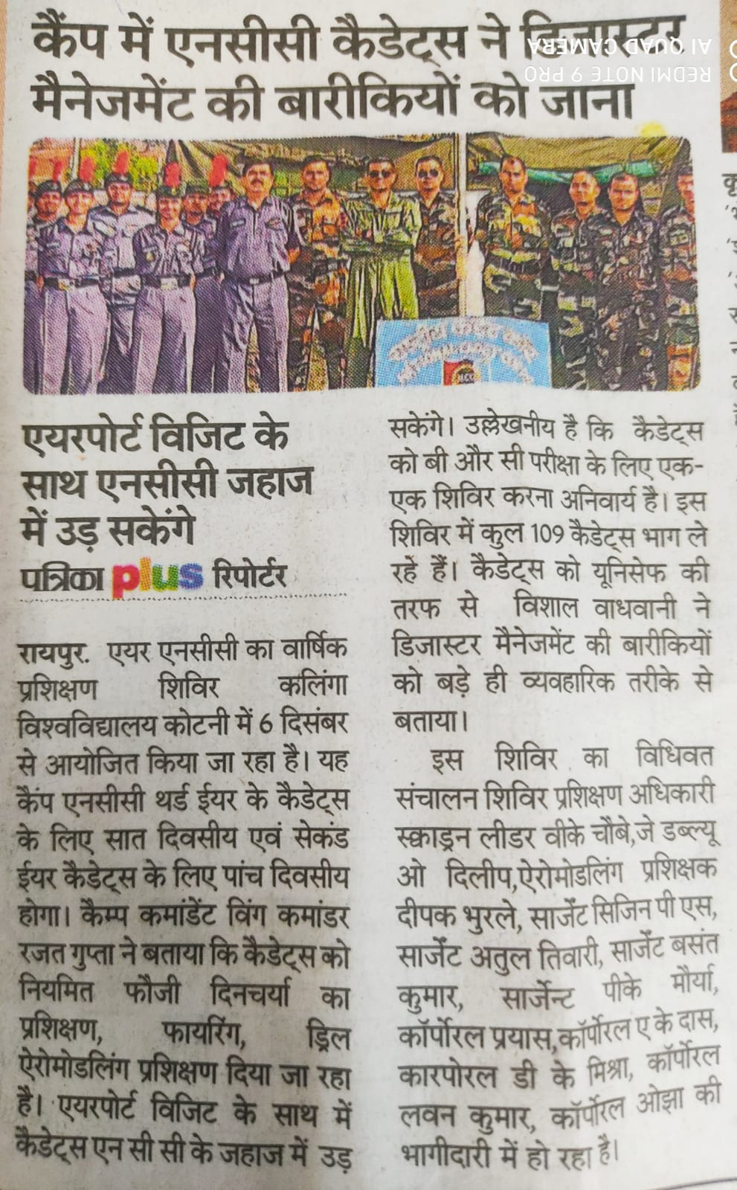
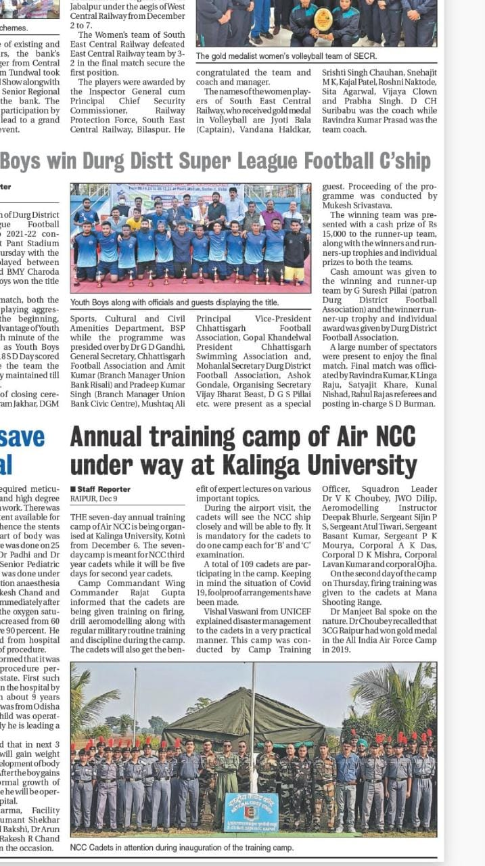
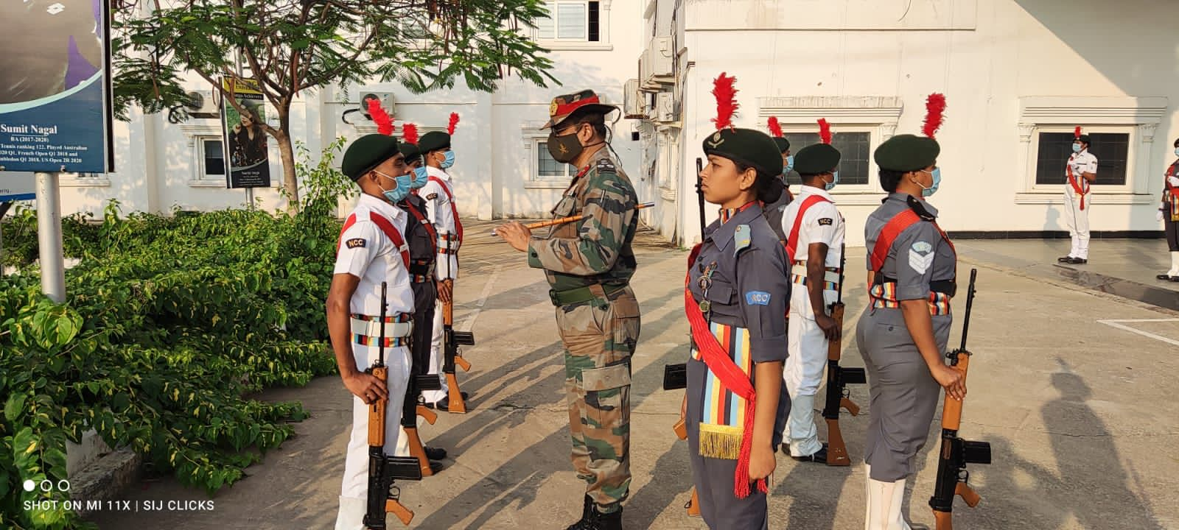
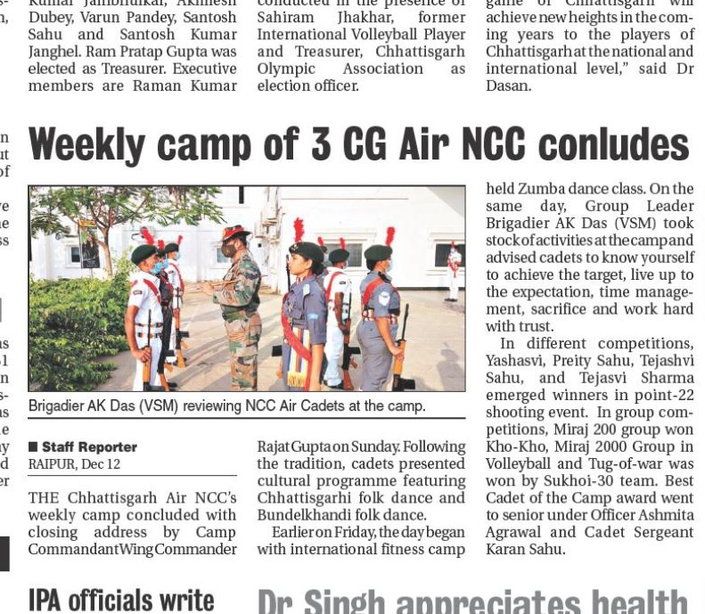
COMBINED ANNUAL TRAINING CAMP ORGANIZED AT KALINGA UNIVERSITY FORM 6TH DEC 2021 TO 12TH DEC 2021.
20 Girl cadets and 39 boy cadets participated along with sqn ldr vijay kumar choubey of Durga college

Slide 9
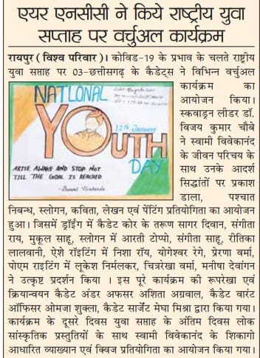
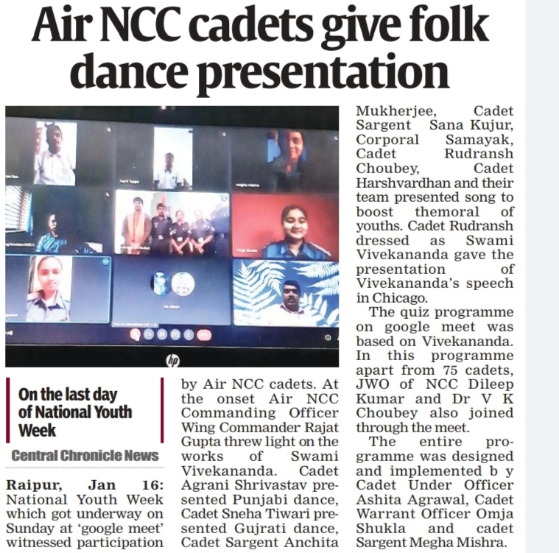
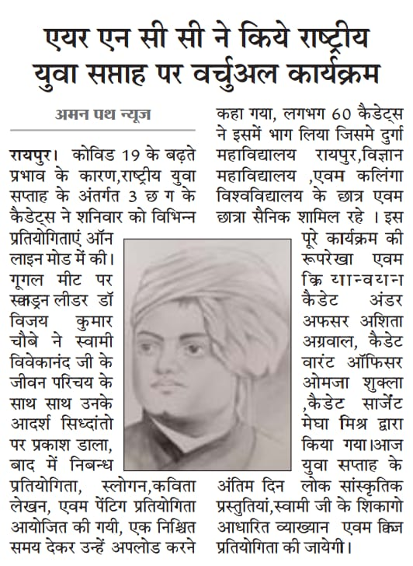
CADETS Organized VIRTUAL PROGRAM ON THE OCCASION OF NATIONAL YOUTH week in January 2022

Slide 10
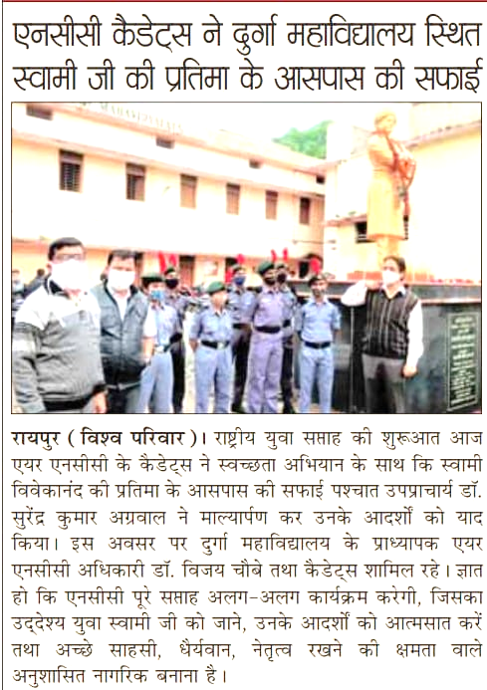
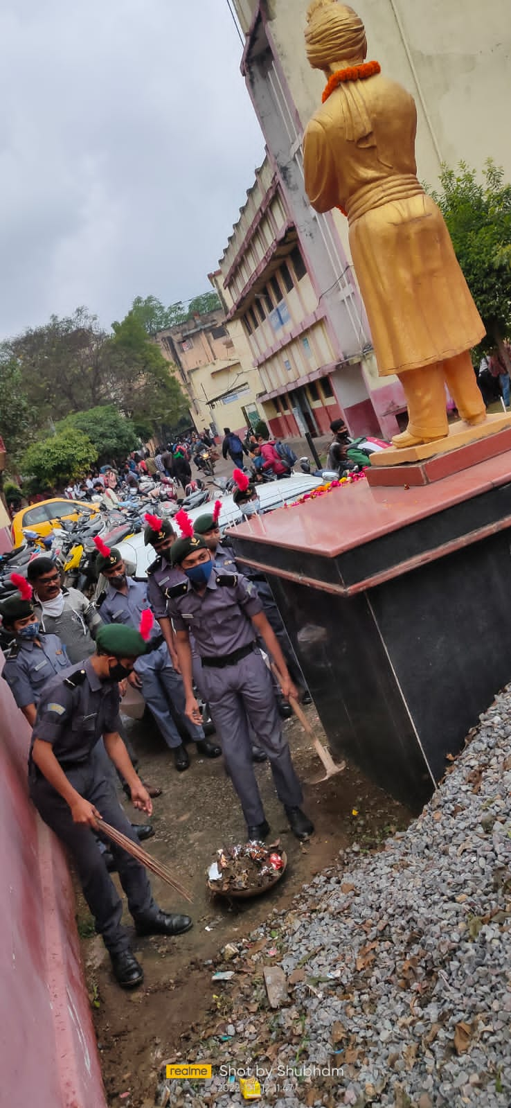
cadets cleaned the statue of swami ji and the surroundings in order to pay homage

Slide 11

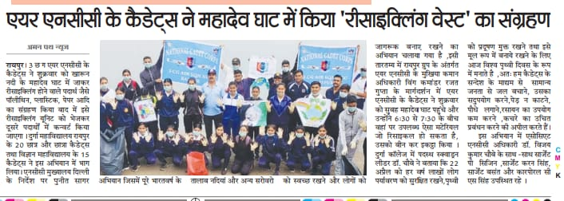
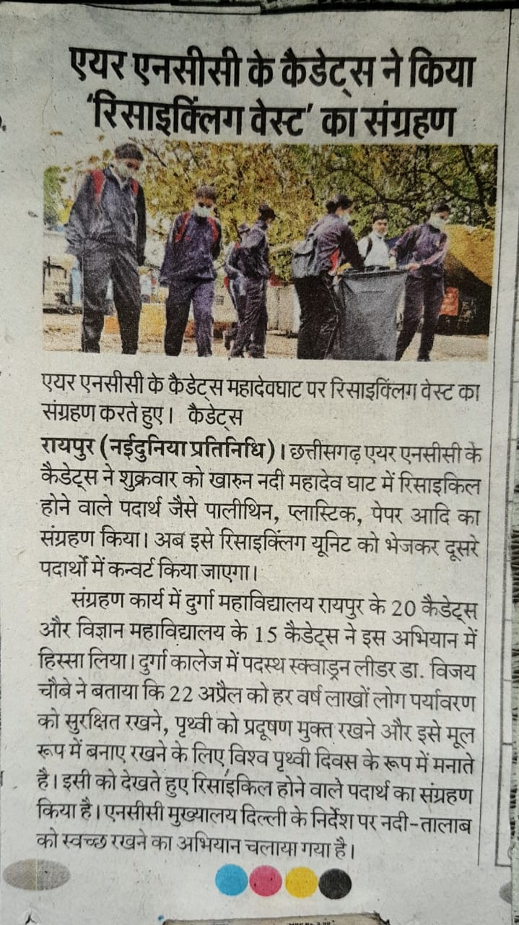
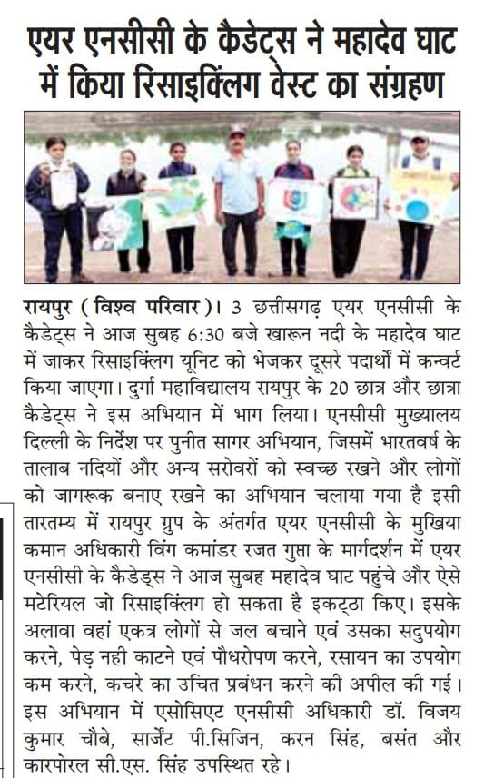
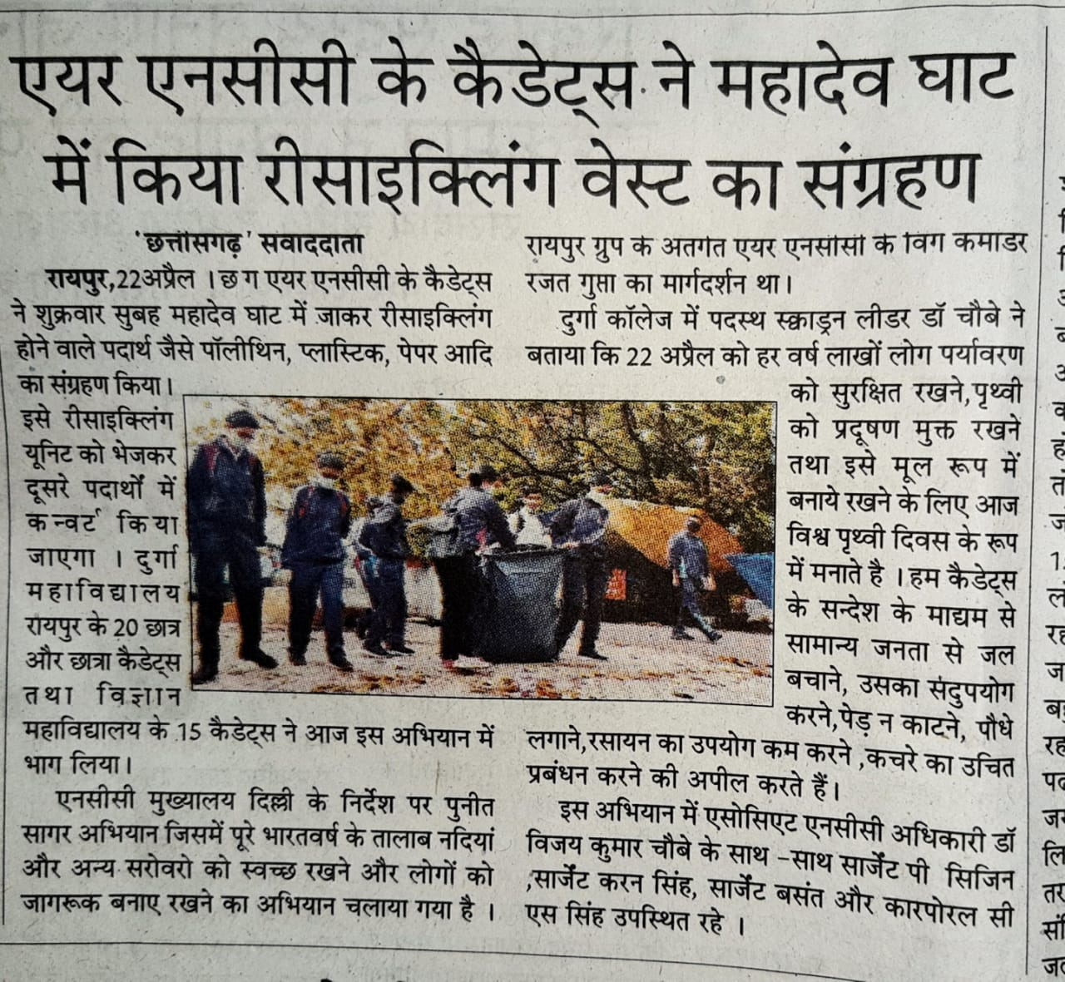
Cadets taking part in “puneet sagar abhiyaan”

Slide 12
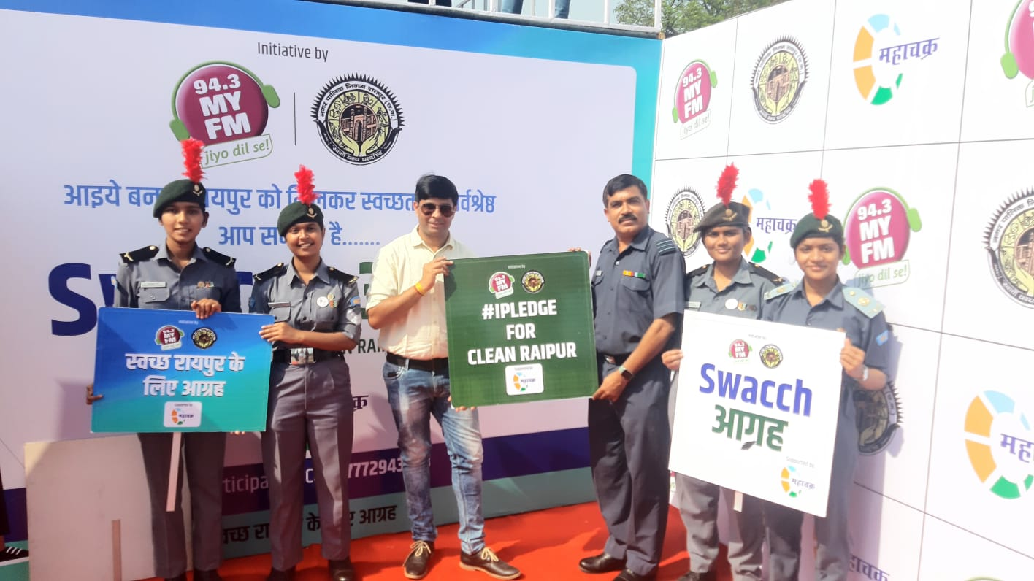
our cadets coordinated with 94.3 my FM and talked about swacch Raipur under the smart Raipur program broadcasted on 28th February 2022

Slide 13

JAY HIND!!!!

