Slide 1

DURGA MAHAVIDYALAYA, RAIPUR (cg)
8 cG GIRLS BN, NCC
NCC ACTIVITIES YEAR- 2019-2020
CAPT(DR) ARCHANA GOMASTA
ASSISTANT PROFESSOR & ASSOCIATE NCC OFFICER

Slide 2

YEAR WISE ENROLLED STRENGTH COMPANY NO-2, PLATOON-A
ORTHRISED STRENGTH | ENROLLED STRENGTH | 1ST YEAR | 2ND YEAR | 3RD YEAR
56 | 56 | 34 | 15 | 7

Slide 3
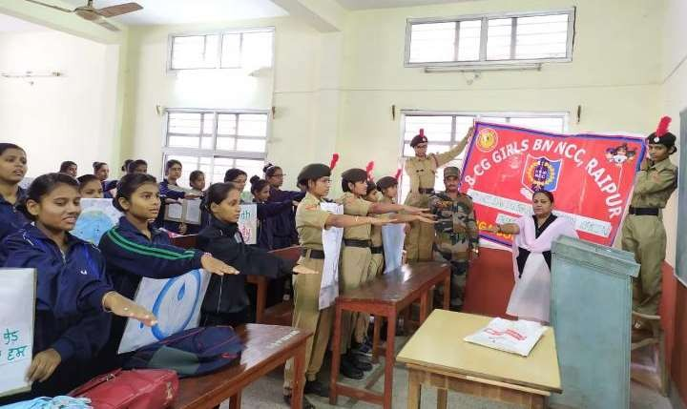
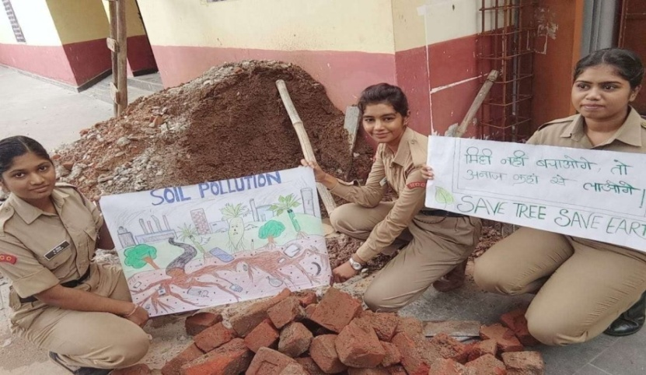
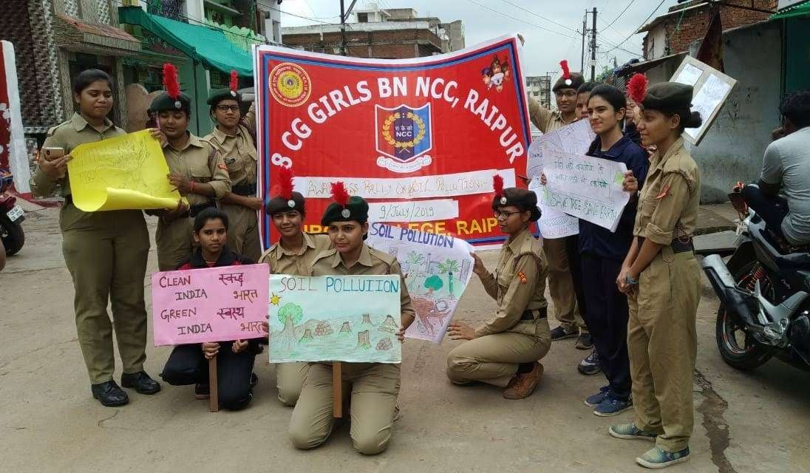
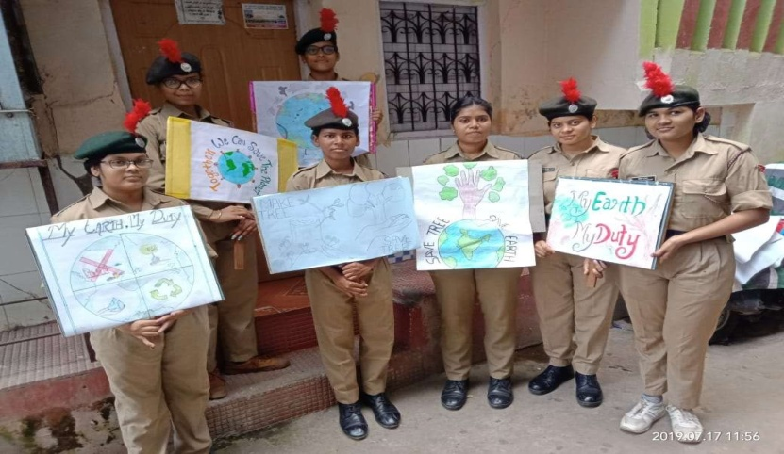
TAKEN Pledged and TOOK OUT RallY ON SOIL POLLUTION AT NEAR BY MOUDHAPARA SLUM AREA on July 9TH, 2019

Slide 4
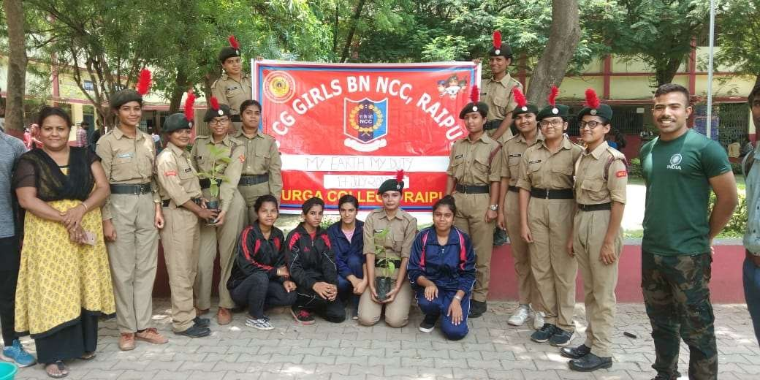
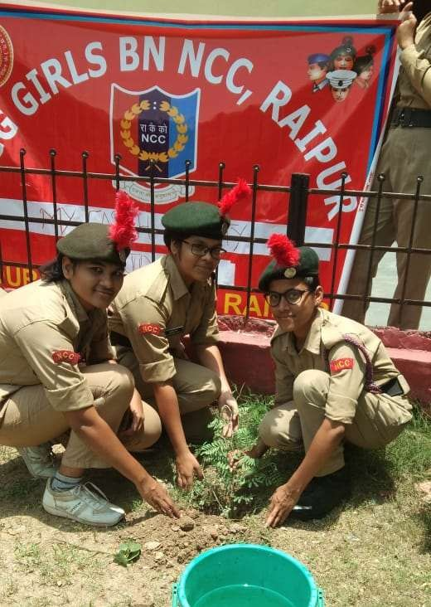
Tree Plantation AT COLLEGE, PREMISES ON JULY 17TH ,2019

Slide 5
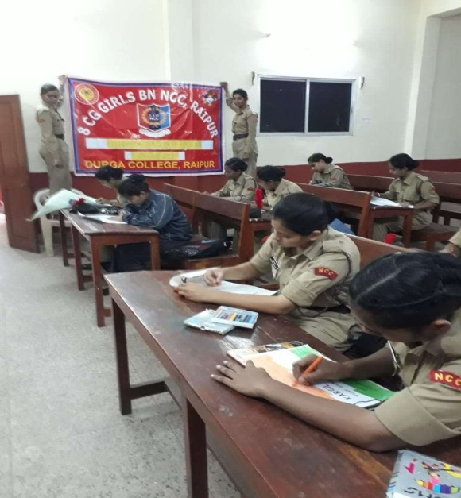
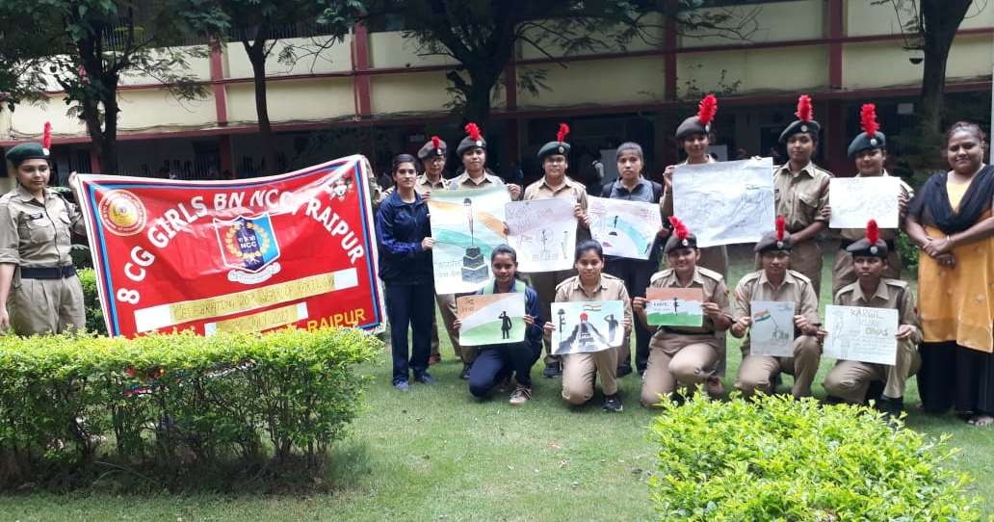
CELEBRATED KARGIL VIJAY DIWAS ON JULY 26TH ,2019
DRAWING COMPETITION WERE CONDUCTED TO TRIBUTE KARGIL WARRIORS

Slide 6
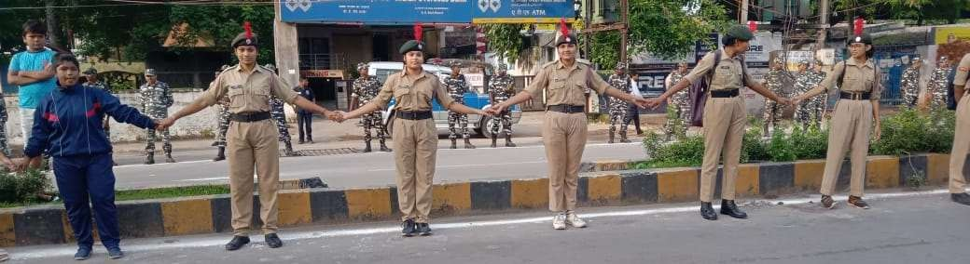
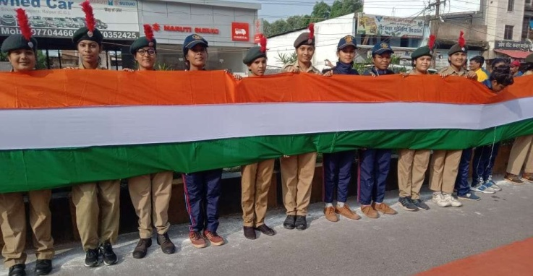
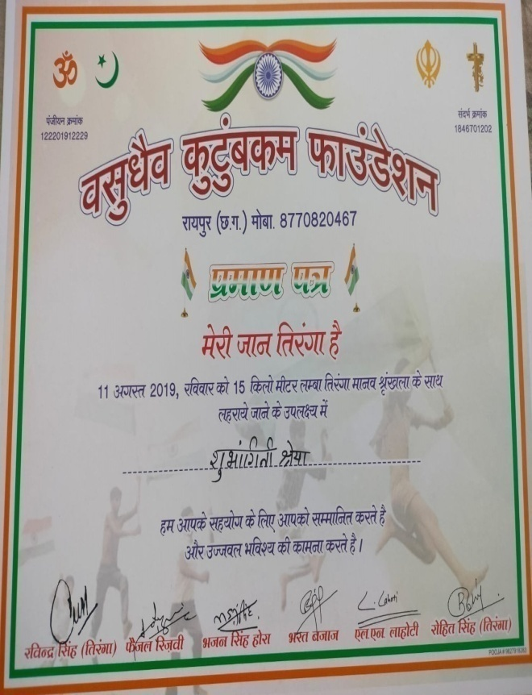
WITH PATRIOTISM cadets participated in Tiranga MARCH Holding 15 km long tricolour flag ON August 11TH, 2019

Slide 7
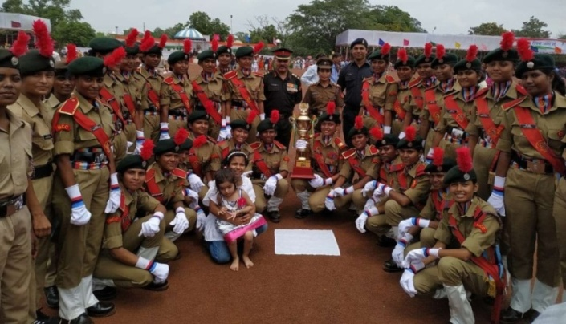
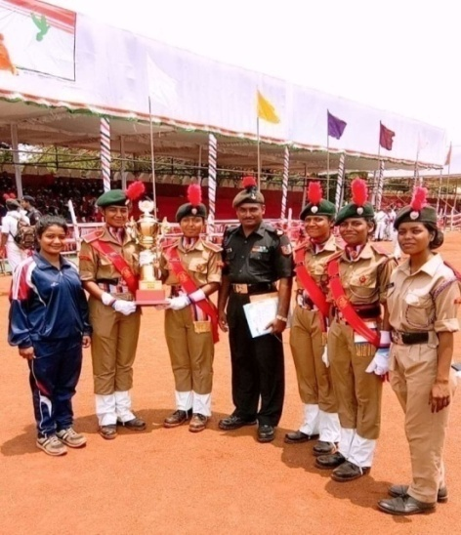
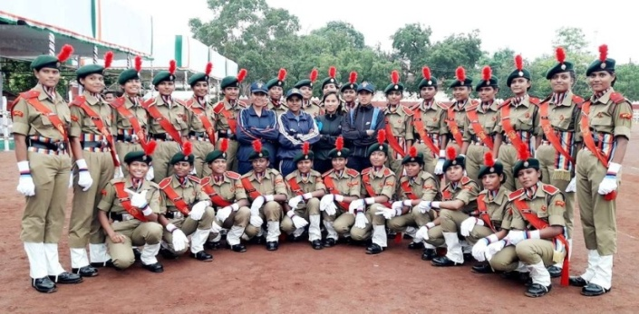
CELEBRATED Independence Day AT POLICE Parade GROUND,RAIPUR ON AUGUST 15TH, 2019
Parade marched infront of
CM Bhupesh Baghel at police ground
Our Battalion RECEIVED first prize.

Slide 8
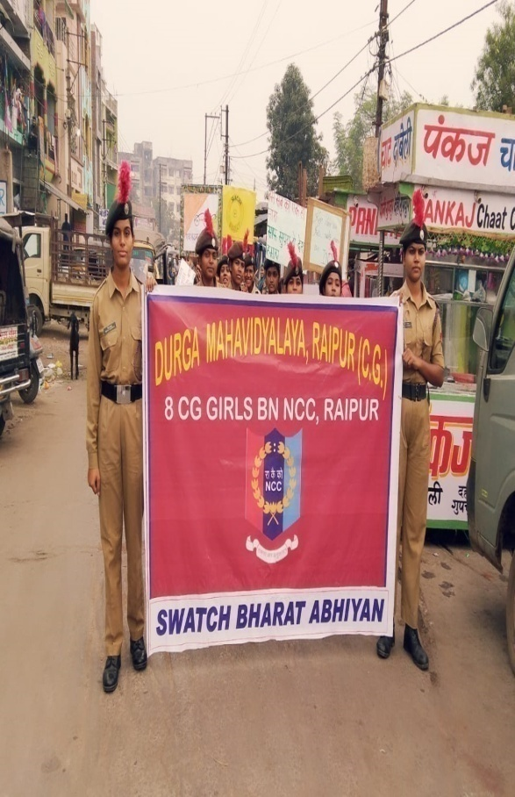
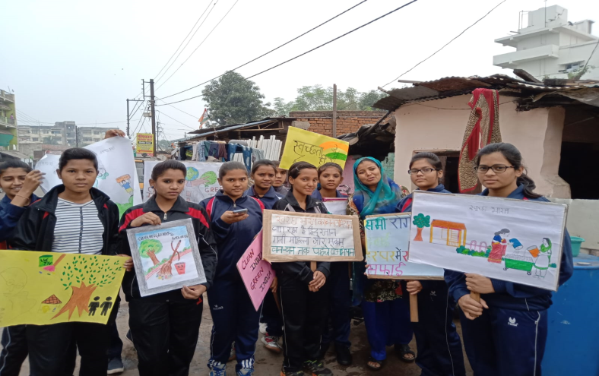
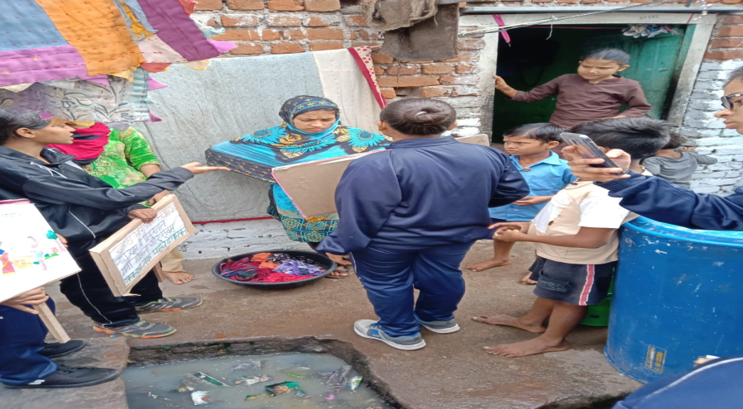
TOOK OUT RALLY AT MOUDHAPARA SLUM AREA ON THE occasion OF SWATCH BHARAT ABHIYAN ON SEPTEMBER 12TH ,2019

Slide 9
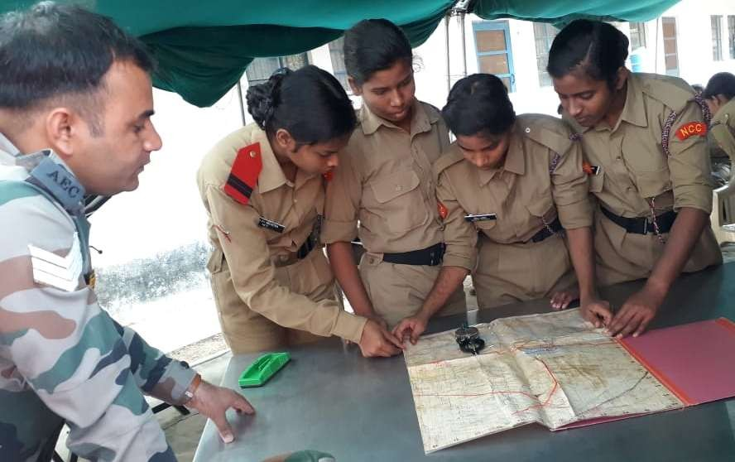
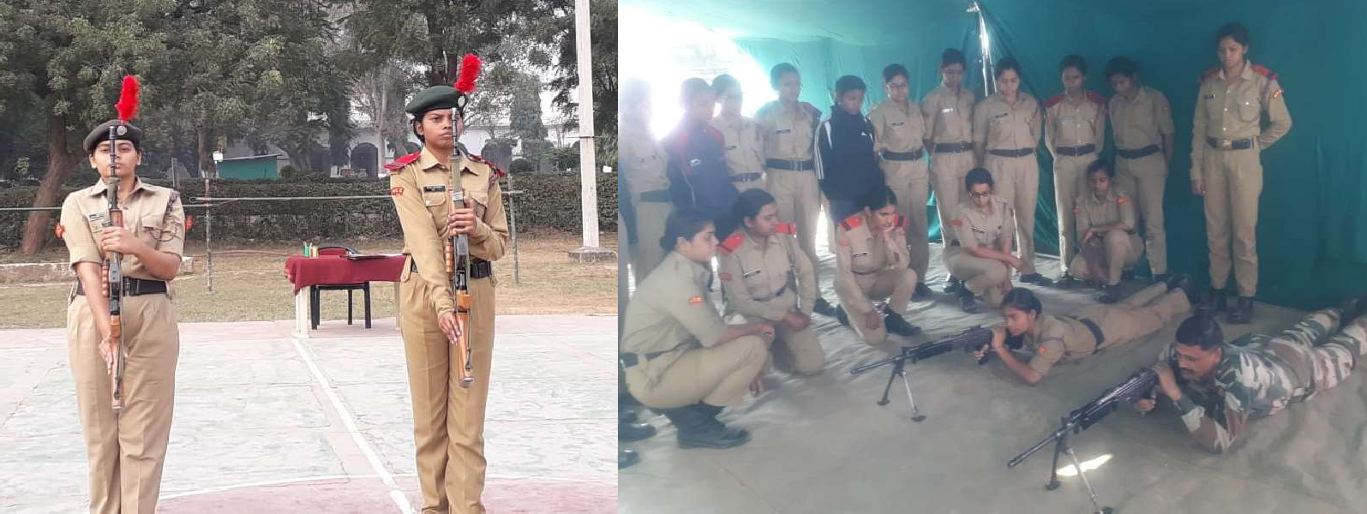
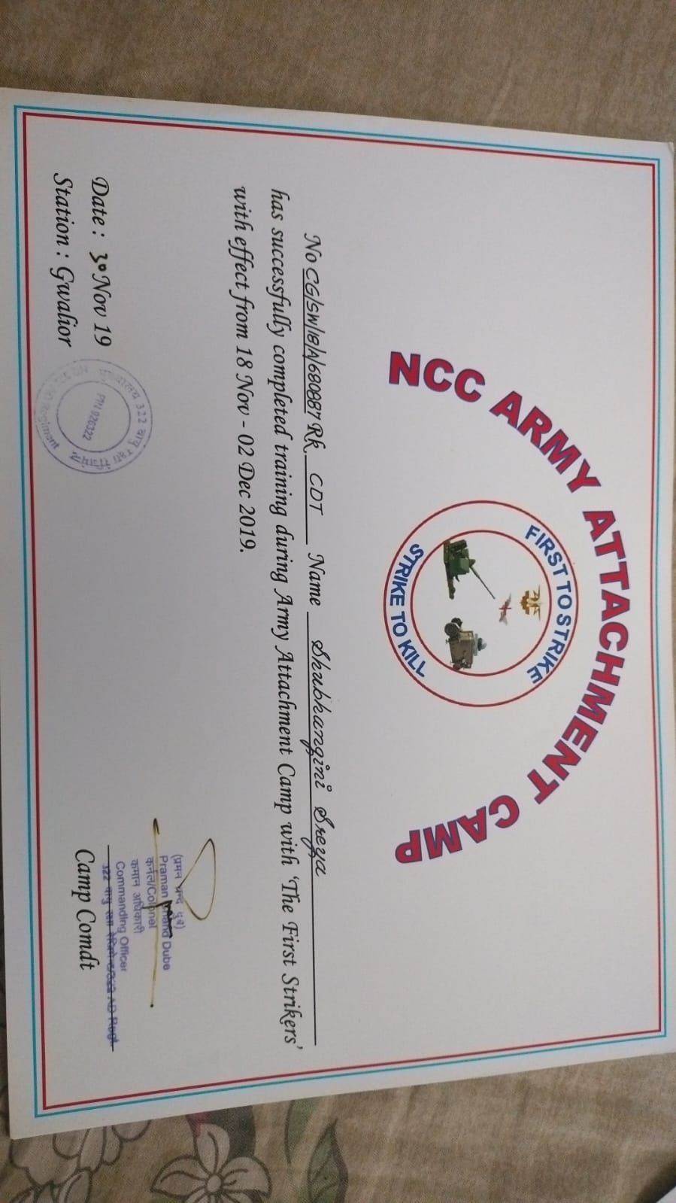
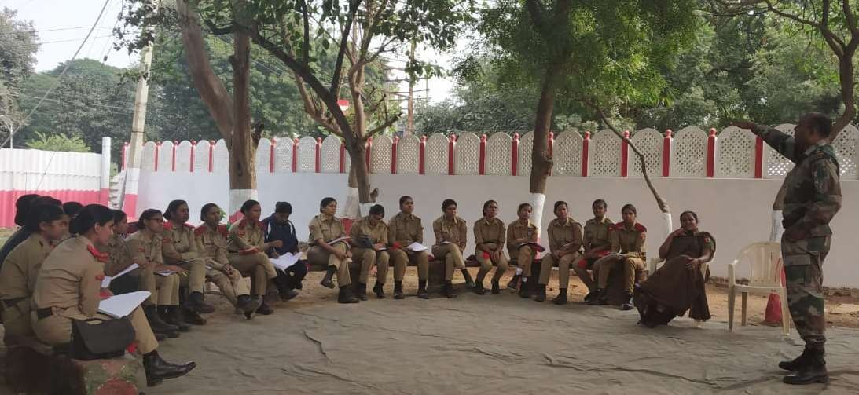
Army Attachment Camp AT Gwalior, MP, on November 18TH, 2019

Slide 10
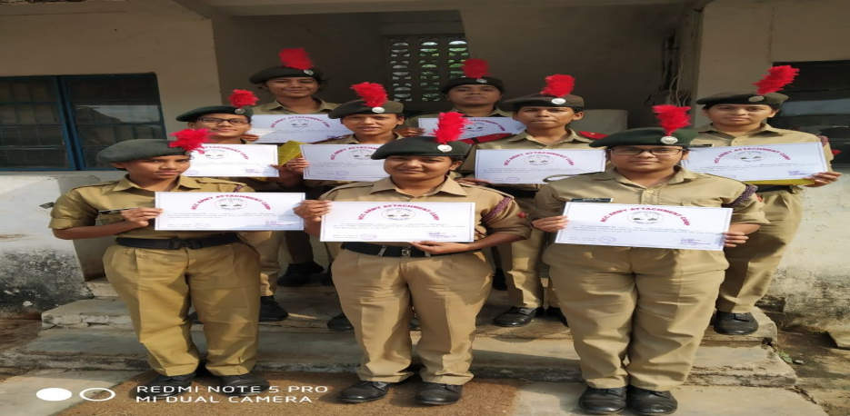
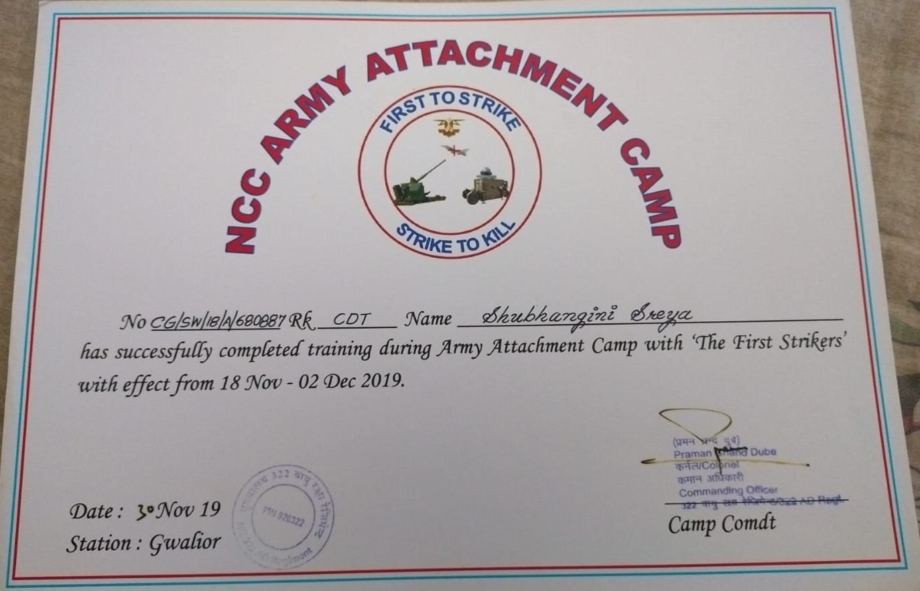
Army Attachment Camp AT Gwalior, MP on November 18TH, 2019

Slide 11
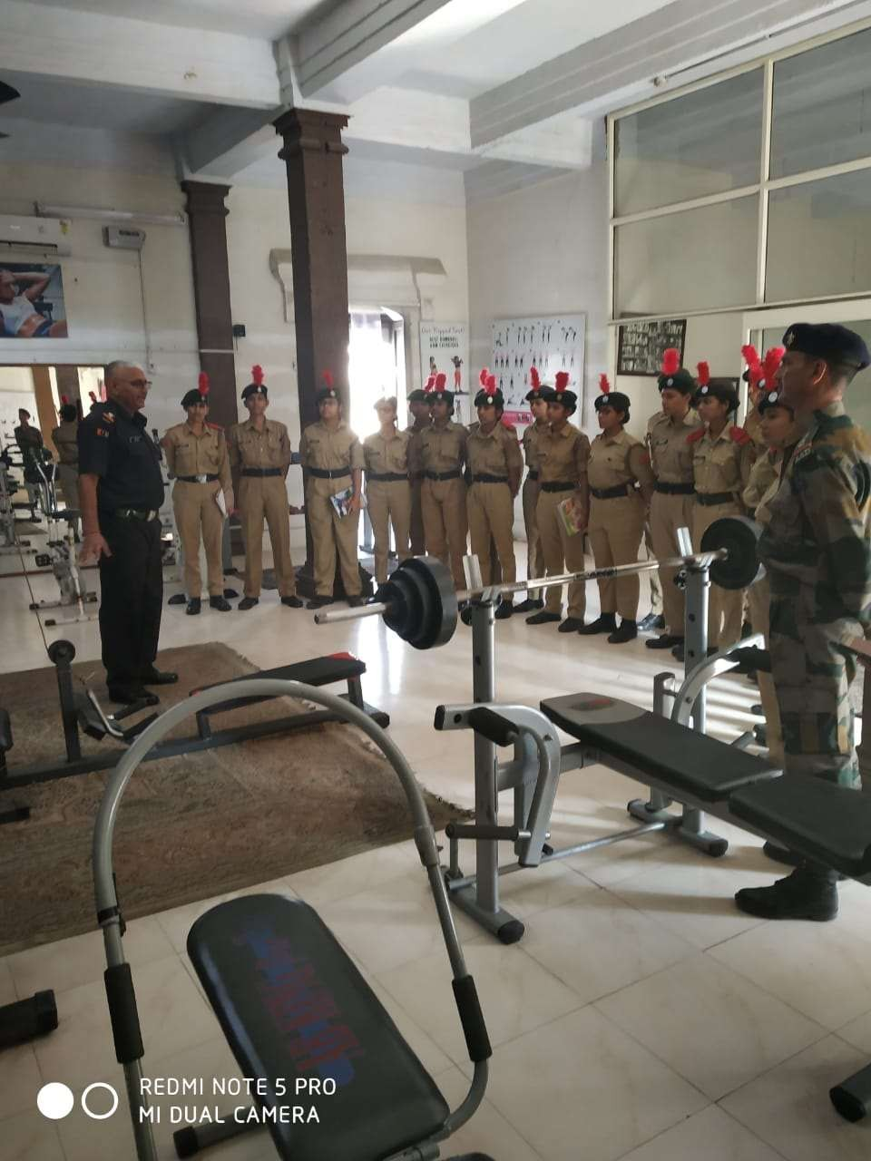
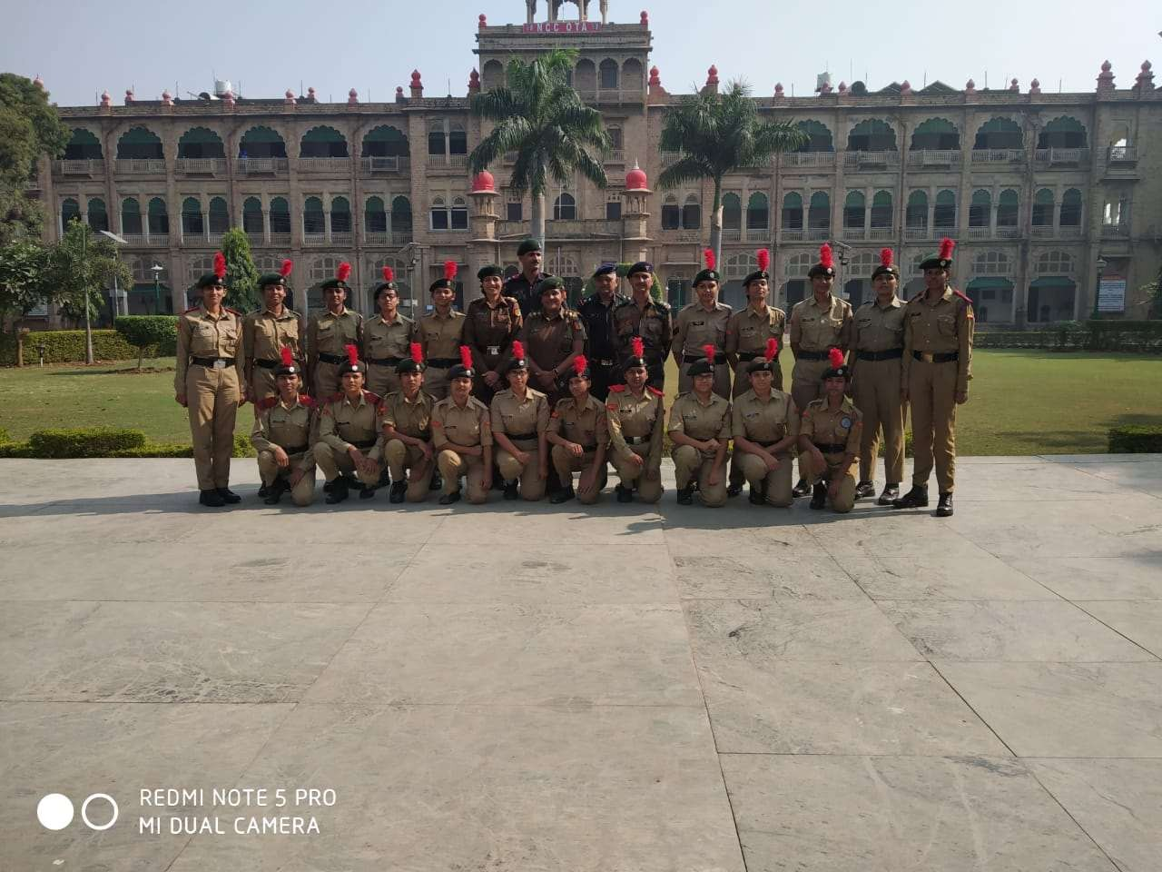
Visited OTA (OFFICERS TRAINING ACADEMY) GWALIOR, MP DURING ARMY ATTACHMENT CAMP

Slide 12
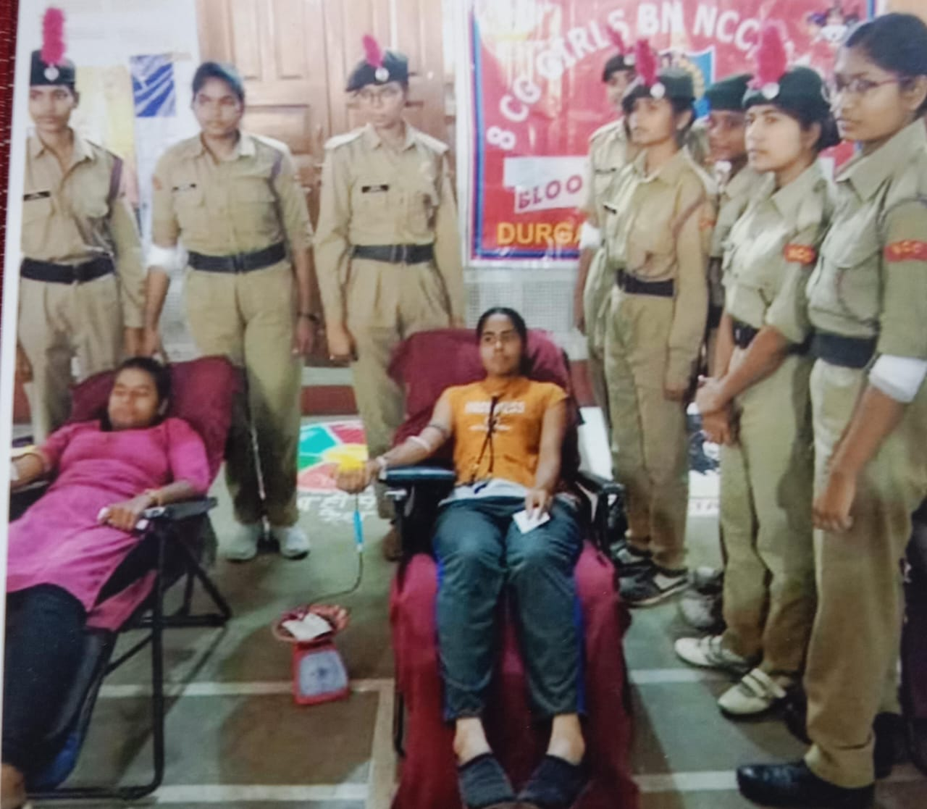
BLOOD DONATION CAMP AT COLLEGE PREMISES 0N DECEMBER,2019

Slide 13
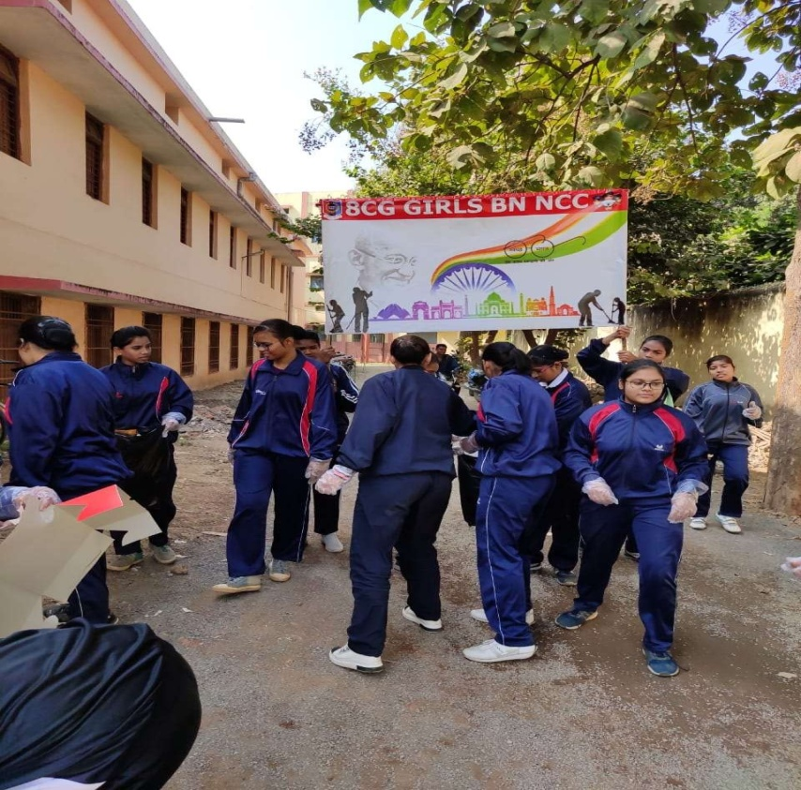
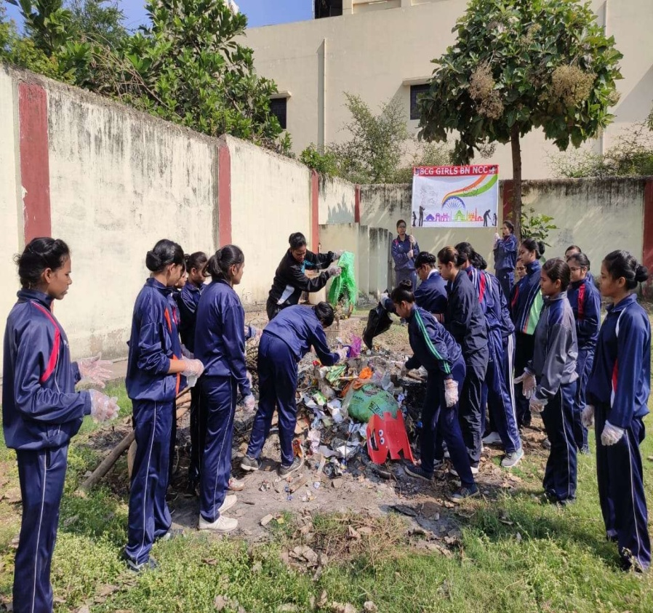
PERFORMED CLEANLINESS ACTIVITY UNDER AGES OF Clean India Green India DRIVE AT COLLEGE PREMISES ON DECEMBER 7TH , 2019

Slide 14
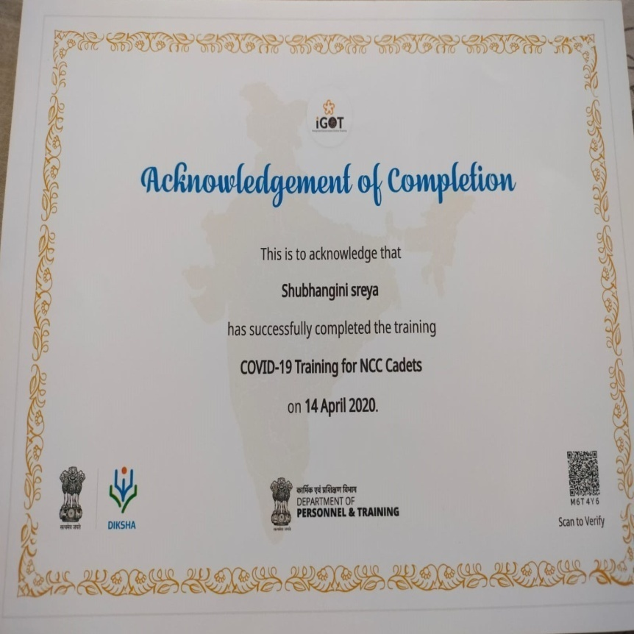
ONLINE COVID-19 TRAINING FOR NCC CADETS ON APRIL 14TH , 2020

Slide 15
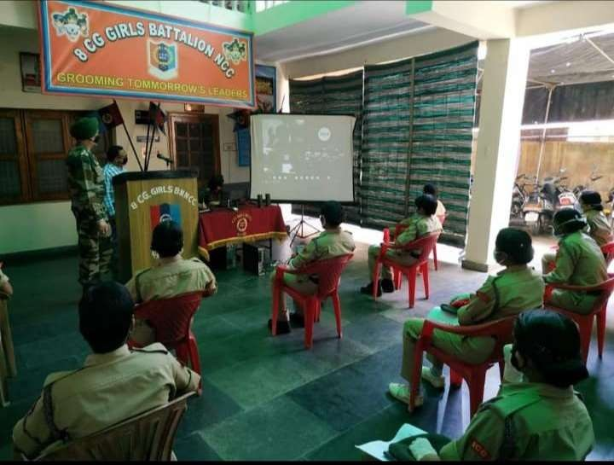
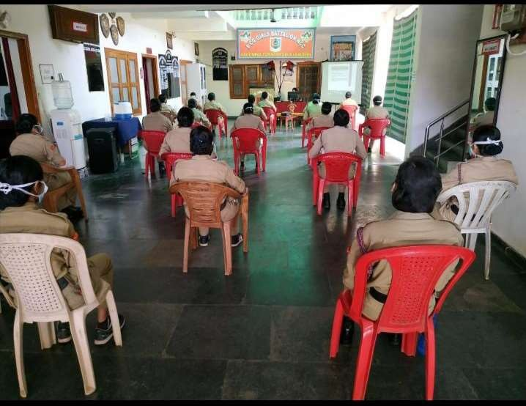
Covid-19 training AT 8CG GIRLS BN, NCC RAIPUR ON MAY 5TH, 2020

Slide 16
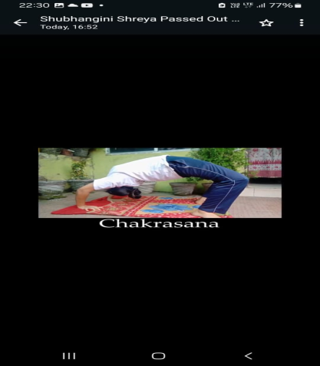
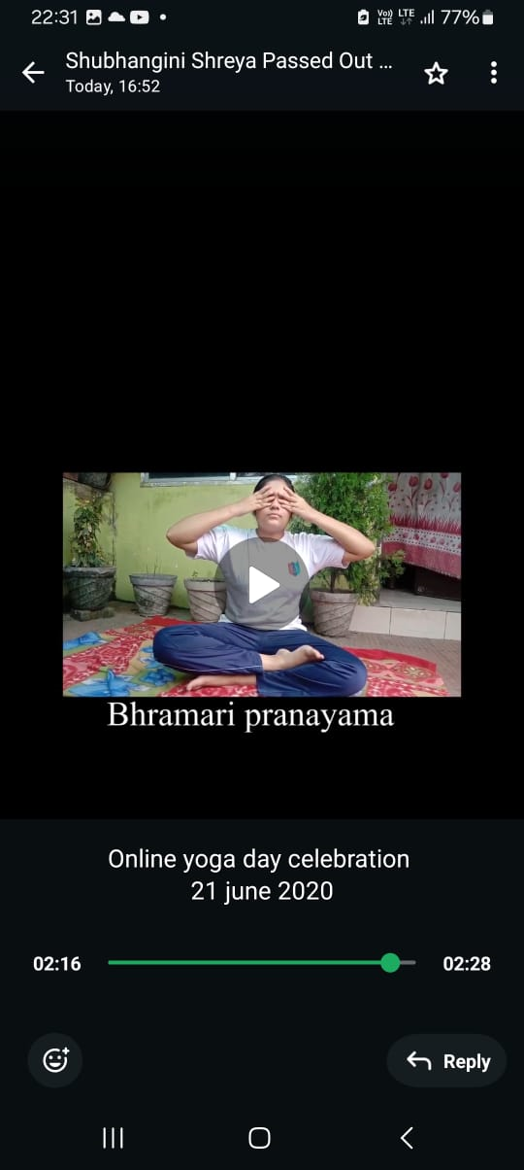
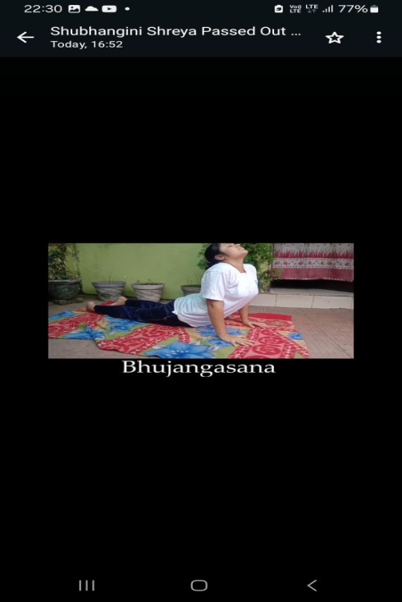
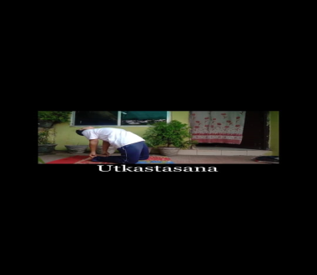
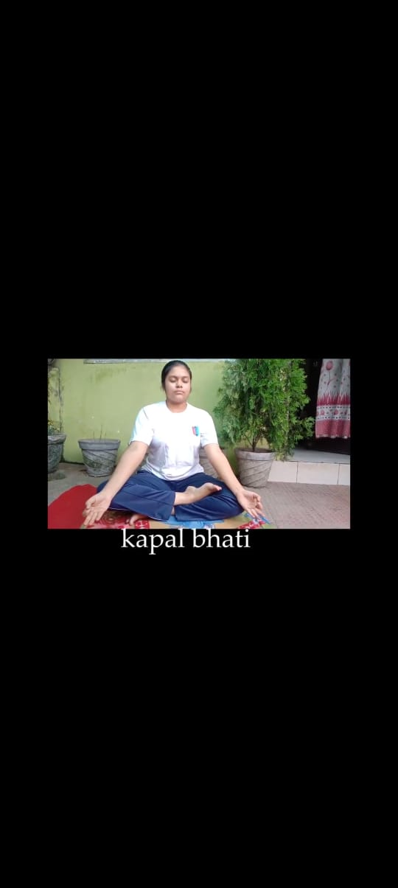
Celebrated ONLINE International Yoga DAY FROM HOME DUE TO PANDEMIC ON JUNE 21ST , 2020

Slide 17
JAI HIND

