Slide 1



Slide 2

Durga Mahavidyalaya Raipur
27 Cg Ncc Bn Raipur
(2022-23)

Slide 3
TOTAL ENROLLED CADET:54
Activity Name | Date
Cleanliness Program of public statue | 18/07/2022
Cleanliness of swami Vivekananda sarovar Raipur | 24/09/2022
Cleanliness Program At oxyzone park | 02/10/2022
Pokhran-II Celebration under Sscd action Plan | 13/05/2023
Blood donation | 23/11/2022
Yoga Day | 21/06/2023

Slide 4
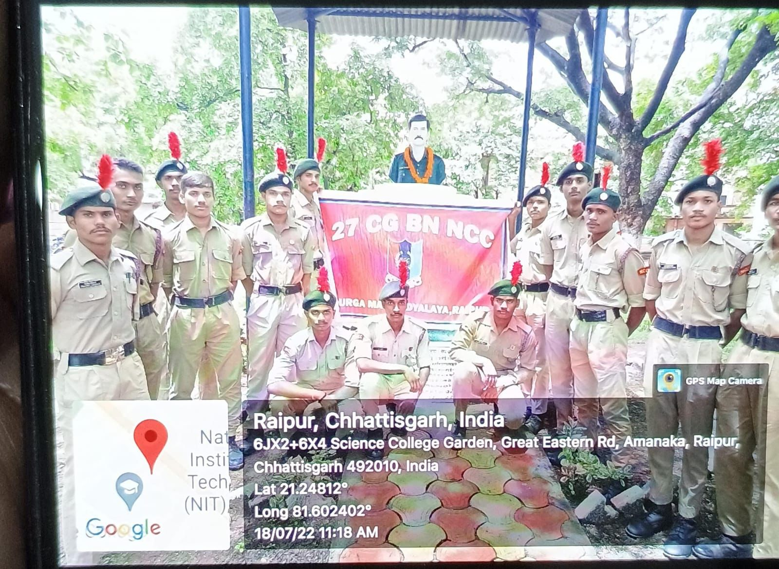
CLEANLINESS PROGRAM OF PUBLIC STATUE : 18/07/2022

Slide 5
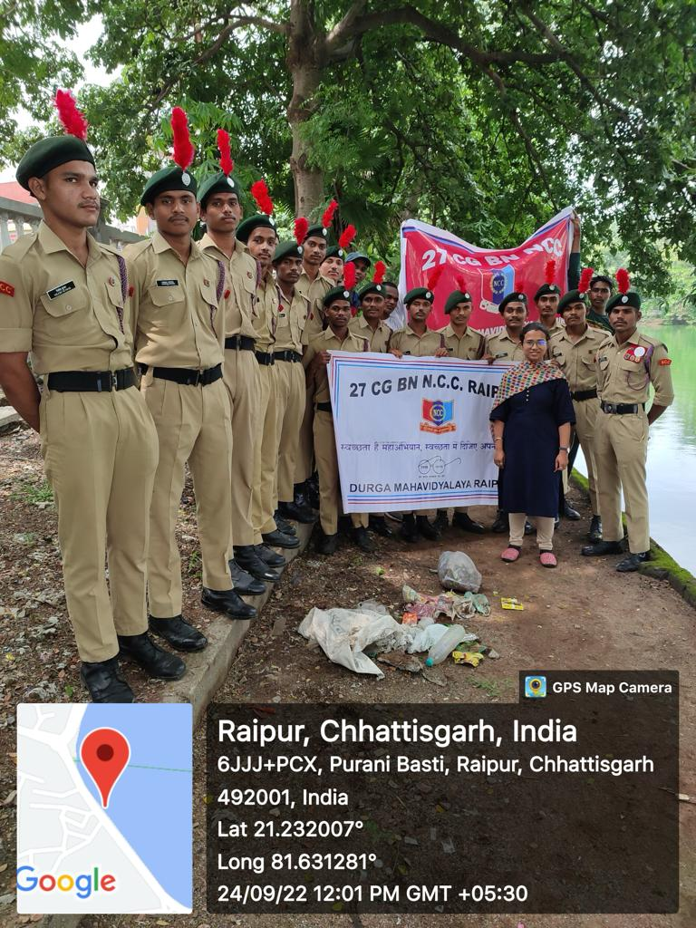
CLEANLINESS OF SWAMI VIVEKANANDA SAROVAR RAIPUR :24/09/2022

Slide 6
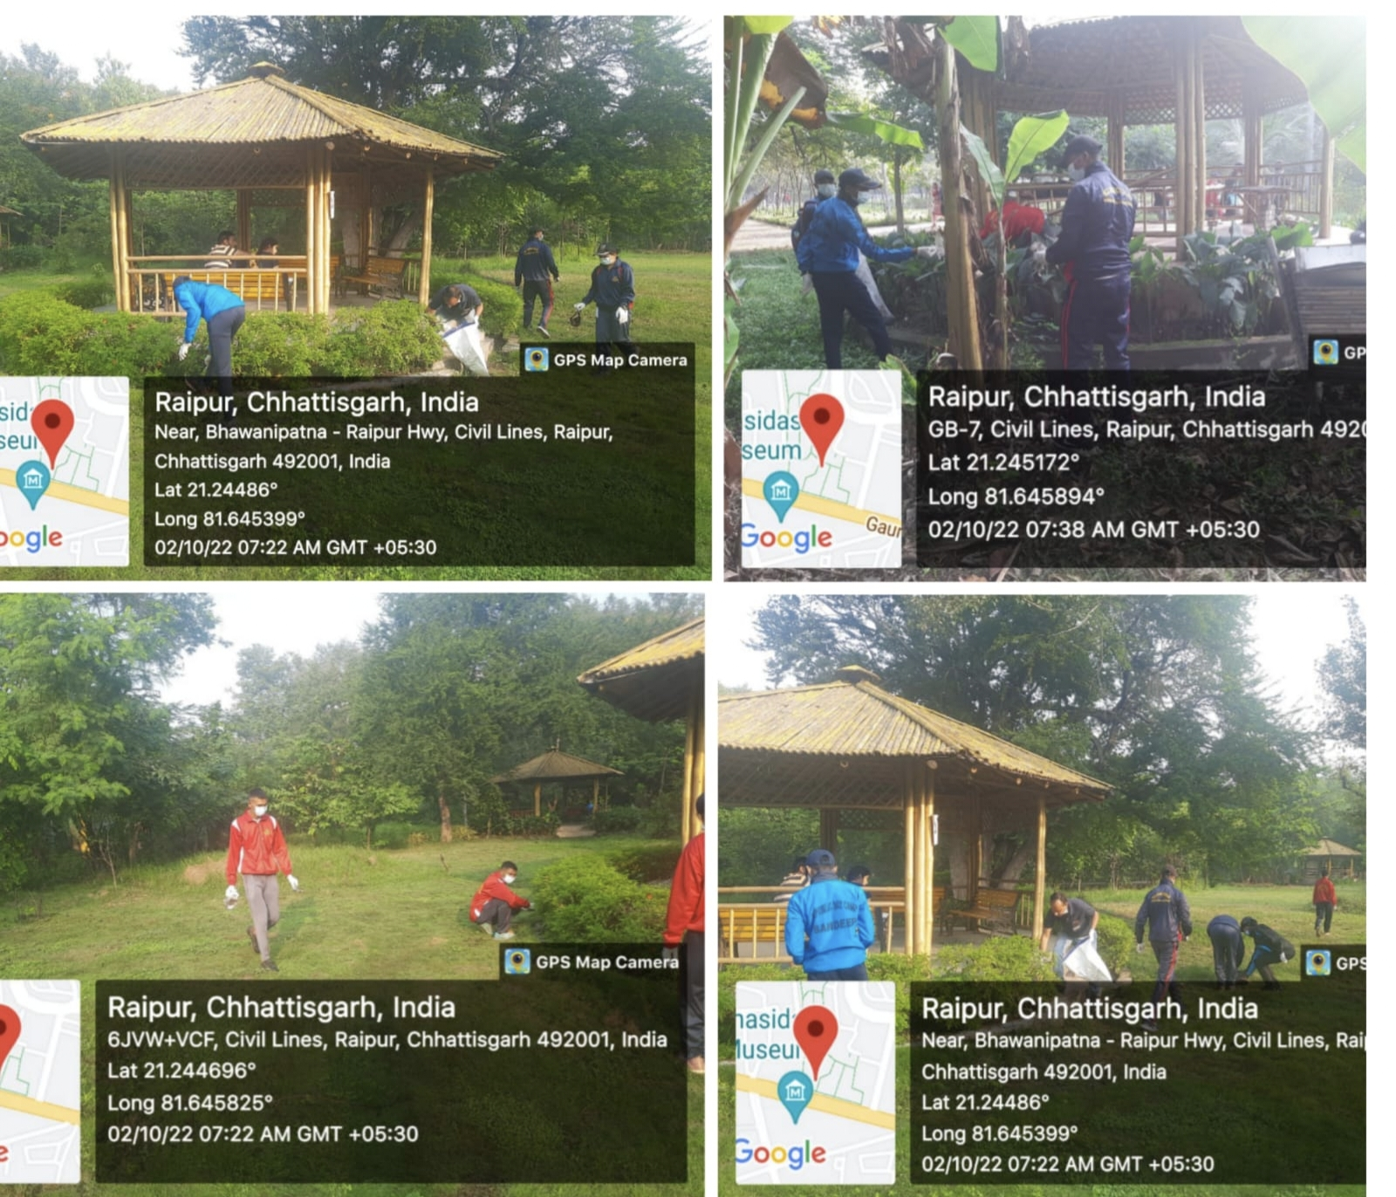
CLEANLINESS PROGRAM AT OXYZONE PARK : 02/10/2022

Slide 7
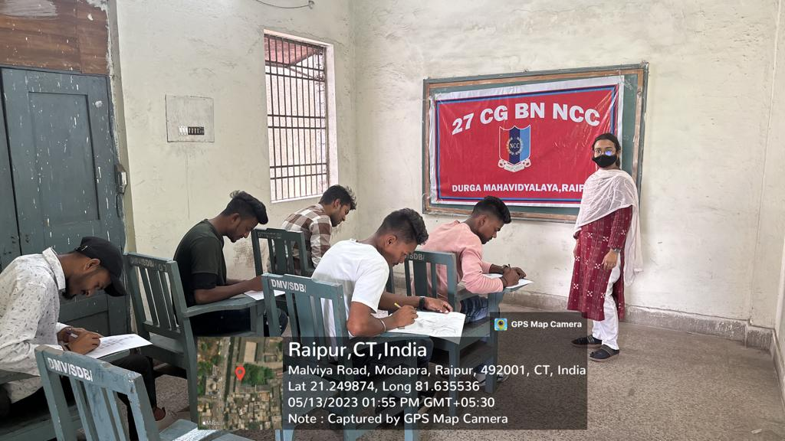
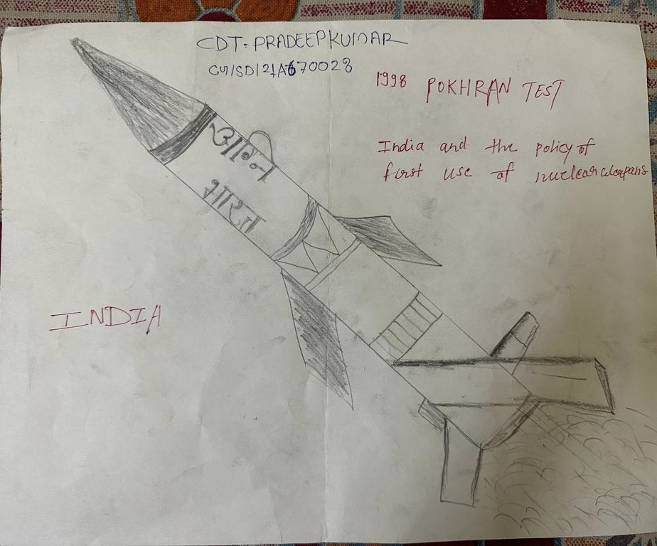
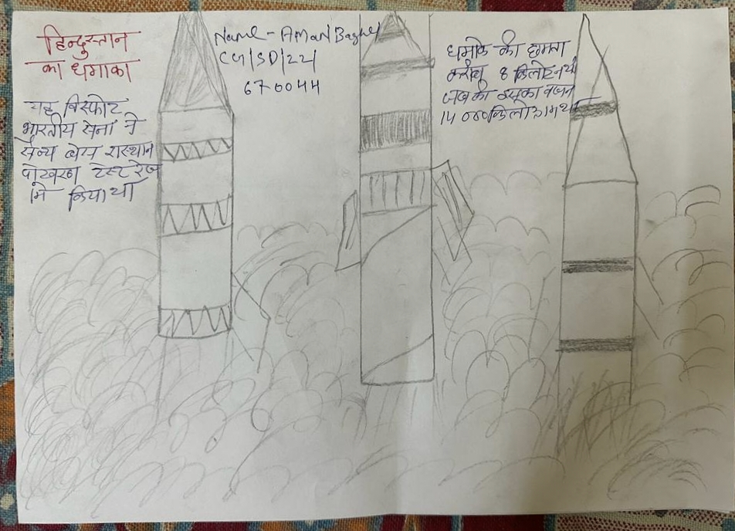
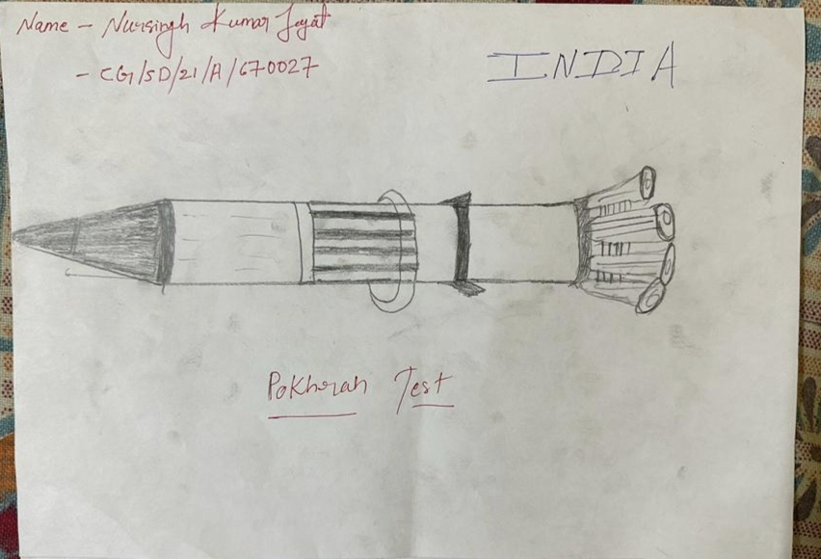
POKHRAN-II CELEBRATION UNDER SSCD ACTION PLAN : 13/05/2023

Slide 8
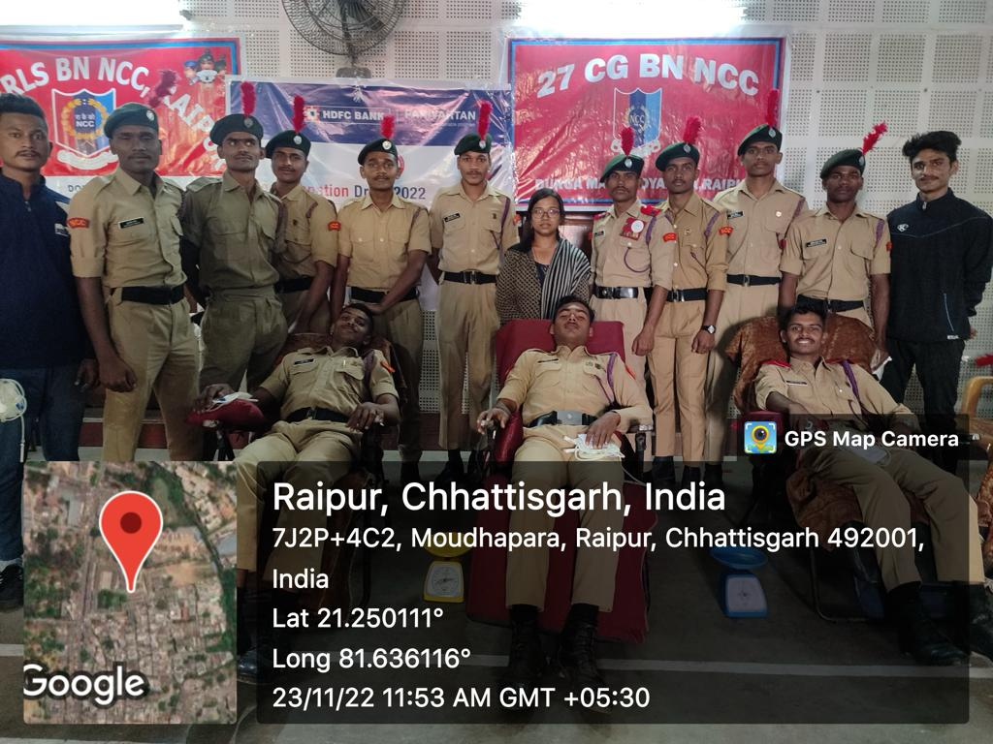
BLOOD DONATION : 23/11/2022

Slide 9
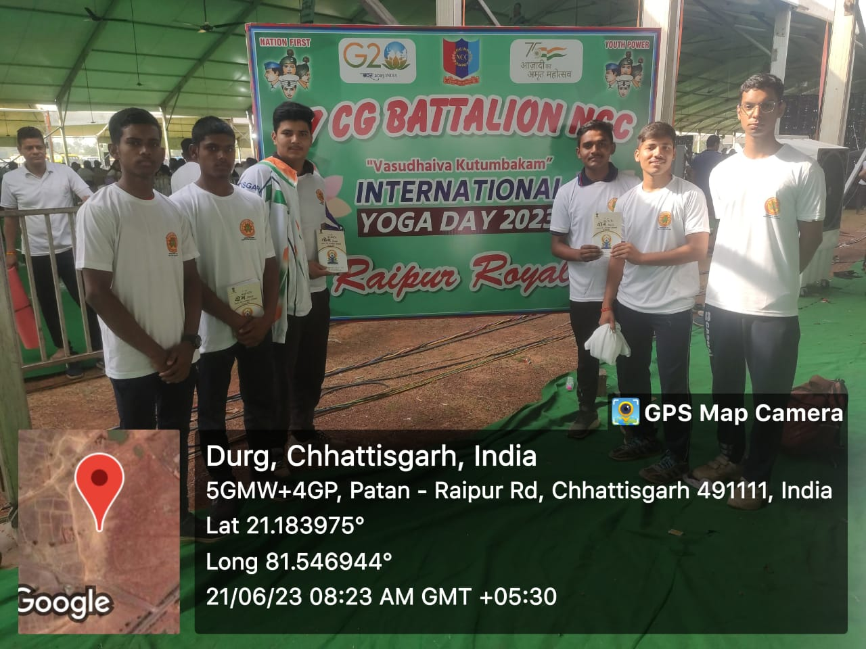
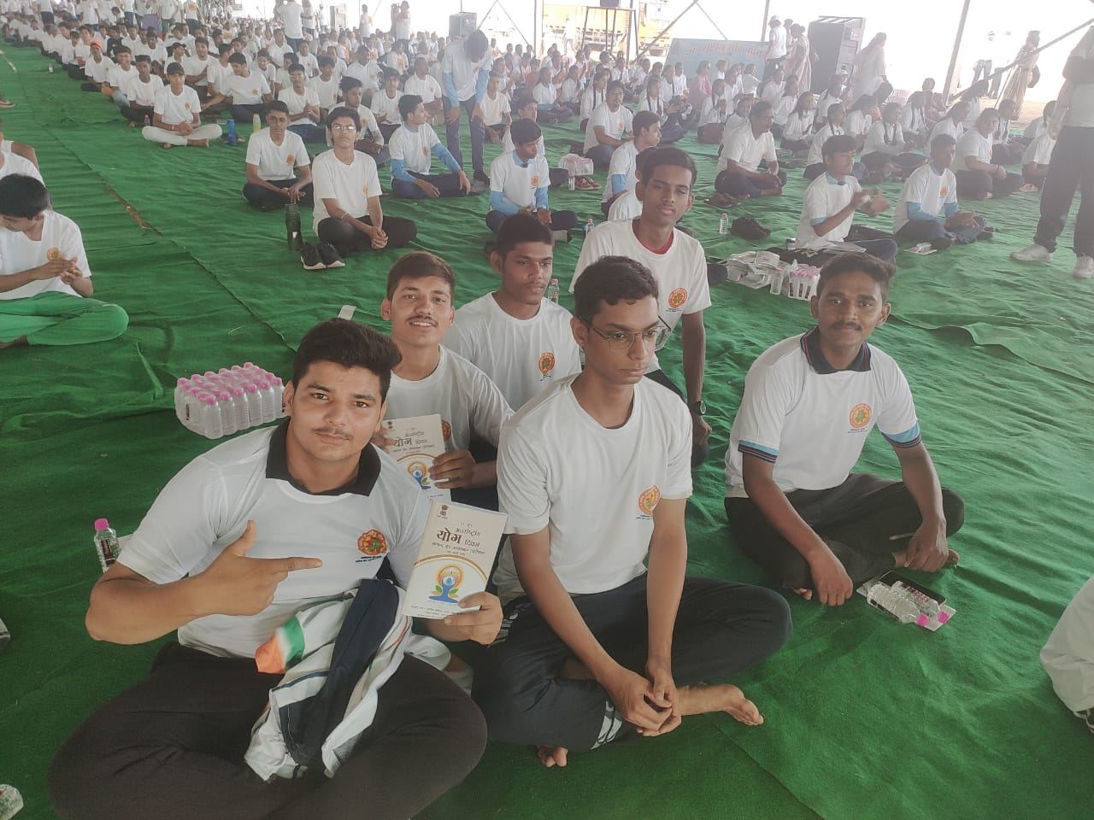
YOGA DAY 🧘: 21/06/2023

Slide 10
THANK YOU

