Slide 1
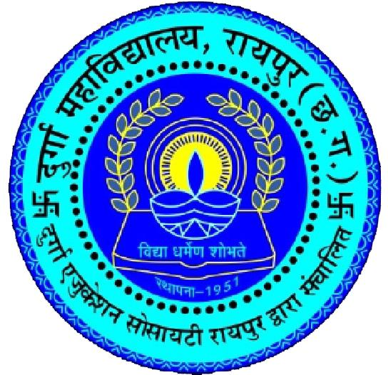
DURGA COLLEGE
K. K. ROAD MOUDHAPARA RAIPUR (C.G)
PHILOSOPHY PRESENTATION
Presented by,
Ms. KUSUM RATHORE

Slide 2

Education
The Word education is derived from the Latin word educo which means to educate, to bring up, or two raise education is a continuous lifelong process.
It is never ending it is start with the birth of an individual and then it goes on till the last day of the individual. man become men through education. He learn something at every moment and on every day.
It is a life long process . It is both theoretical and practical

Slide 3

Types of Education
Formal Education – Formal education refers to the structured and organized learning takes place institution. It also refers to the basic academic knowledge that a child learns in formal manner. such education is provided by especially qualified teachers who are sufficient in a with art of instruction. Exp.- classroom class room learning planned education with a definite proper syllabus.
Informal education – it occurs outside of traditional classroom settings and often involves learning through daily experiences. Examples: Reading Books, Online Learning Platforms, Travel and Cultural Experiences, Community Involvement, Conversations and Discussions, Observation of Nature, etc.

Slide 4

Nature of Education
1. शिक्षा सामाजिक प्रक्रिया
Social process of education
2. शिक्षा गतिशील प्रक्रिया
Dynamic process of education
3. शिक्षा द्विध्रुवी प्रक्रिया
Education bipolar process।
4. शिक्षा अनवरत प्रक्रिया
Continuous process of education.
5. शिक्षा विकास की प्रक्रिया
Process of education development.
6. शिक्षा सर्वांगीण विकास की प्रक्रिया
Education All-round development process

Slide 5

Objective of Education
The objectives of education are multifaceted, reflecting the complex nature of preparing individuals for a diverse and interconnected world. It includes:
  Knowledge Acquisition
  Critical Thinking Skills
  Skill Development
  Character Development
  Social Integration
  Cultural Understanding
  Personal Growth
  Economic Empowerment
  Global Awareness
  Adaptability

Slide 6
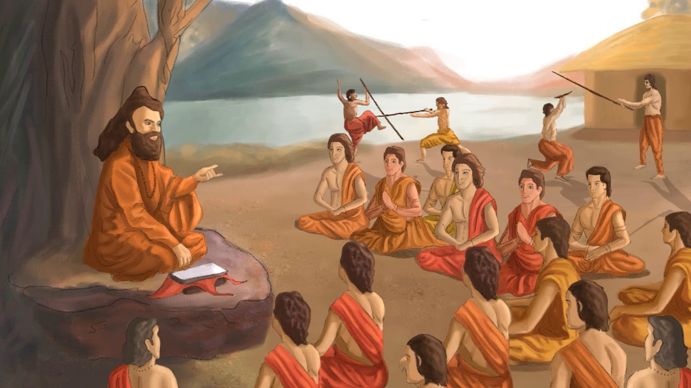
Education in Ancient India
Education in ancient India had a rich and multifaceted tradition that dates back thousands of years. It laid the foundation for a holistic approach to learning, integrating spiritual, intellectual, and practical aspects of life. It Includes:
Gurukul System
Vedas and Scriptures
Varied Subjects
Oral Tradition
Caste-based Education
Ashram System
Focus on Moral Values
Universities and Centres of Learning- Takshashila and Nalanda
Practical Application

Slide 7
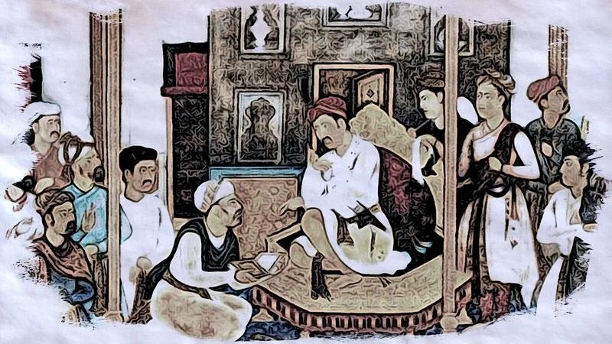
Education in Medieval India
During medieval times in India, education continued to be an integral part of society, with certain evolutions and developments. Despite challenges and changes, education in medieval India retained its diversity, with the coexistence of various educational traditions influenced by both indigenous and foreign elements. Key features:
  Madrasas and Maktabas
  Gurukuls and Brahminical Learning
  Persian Influence
  Libraries and Manuscript Culture
  Development of Vernacular Literature
  Sufi and Bhakti Influence
  Role of Temples and Mathematics
  Decline of Some Traditional Centres
  Educational Patronage

Slide 8
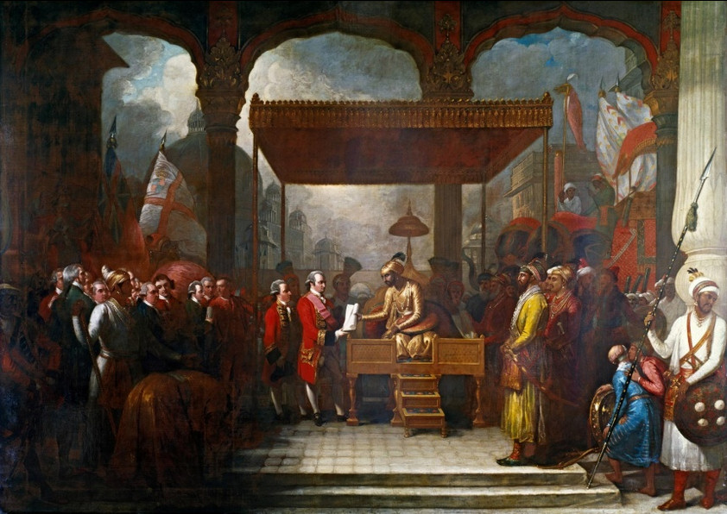
Education in Modern India
In modern India, the education system has undergone significant transformations with the influence of colonial rule, independence, and subsequent socio-economic developments. Ongoing reforms seek to address current challenges and shape a more inclusive and dynamic educational landscape. Key features:
  British Influence
  Macaulay’s Minute (1835)
  Wood’s Despatch (1854) - ‘Magna-Carta’ of English Education in India.
  University System
  Hunter Commission (1882)
  Indian Education Act of 1901
  Sargent Plan (1944)

Slide 9

Post-Independence Reforms in Education
These reforms reflect the ongoing efforts to address the diverse needs of India’s education system, promoting inclusivity, quality, and relevance to the changing socio-economic landscape. Key points:
  University Education Commission (1948-1949): (Radhakrishnan Commission)
  Kothari Commission (1964-1966)-introduction of a 10+2+3 system.
  National Policy on Education (1968)
  National Education Policy (1986)
  Sarva Shiksha Abhiyan (SSA) – Education for All (2001)- 6-14 age group
  Right to Education Act (2009)
  National Skill Development Mission (2015)
  National Education Policy (NEP) 2020 – 5+3+3+4 structure

Slide 10
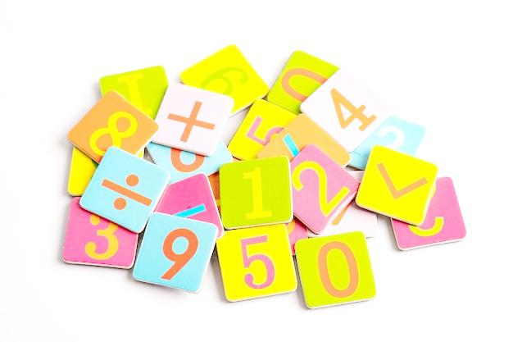
Conclusion
The journey of education in India has been marked by a rich tapestry of historical, cultural, and socio-economic influences. From ancient Gurukuls to the colonial-era reforms and post-independence initiatives, education has evolved significantly.
The traditional systems laid the foundations for holistic learning, emphasizing not only academic knowledge but also moral and spiritual development. The British colonial period introduced a formalized structure with an emphasis on English education, leading to the emergence of a Western-educated elite.
Post-independence, India undertook ambitious reforms to democratize education, striving for universal access and quality.
Despite progress, challenges remain, including issues of accessibility, quality, and regional disparities. Ongoing reforms seek to address these challenges.

