Slide 1

A STUDY OF MORPHOLOGY
DR MADHU KAMRA
HOD, ASSISTANT PROFESSOR
DEPARTMENT OF ENGLISH
DURGA MAHAVIDYALAYA

Slide 2
Morphology
A Field of Linguistics
Derived from Greek words-
    Morph’ – ‘Shape’/ ‘Form’
    Ology- ‘The study of’
Hence Morphology is the study of words
First used for linguistics purposes in 1859 by the German Linguist August Schleicher.

Slide 3
TYPES OF MORPHEMES
FREE
Occurs independently
Meaningful units be fully meaningful
Supplementary meaning
BOUND
Occurs as dependant units
Attached to others units
Eg: Costly has two Morphemes
Free- ‘Cost’
Bound – ‘ly’
= word -Costly

Slide 4
MORPHOLOGY
TWO BRANCHES
LEXICAL or DERIVATIONAL
INFLECTIONAL
CLASS CHANGING CLASS MAINTAINING
Study of process including:
Affixation
Vowel Change

Slide 5
Difference
Creation of new words
existing word
grammatical functions like-
1. Number
2. Tense
3. Person
4. Case
5. Gender
CHANGE OCCURS IN EXISTING FROM WORDS THROUGH

Slide 6
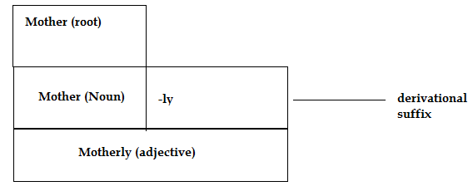
Examples of Morphological split
Motherly
Class changing derivational Morphology
‘Mother’ Free Morpheme
‘-ly’ Bound Morpheme

Slide 7
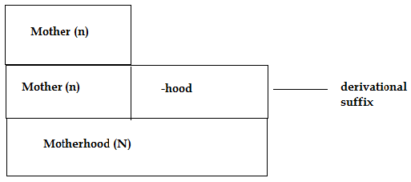
Example 2
Motherhood (n)
Class maintaining Morphology
‘Mother’ Free Morpheme
‘-hood’ Bound Morpheme

Slide 8
Remember Formations
Dom filmdom, kingdom, boredom (Noun-Noun)
Star gangster, monster
al approval, betrayal (verb - Noun)
al personal, tribal, maternal, occasional
(Noun - adjective)
ness (optional) happiness, unhappiness (adjective - noun)
Re redo, rewrite, rethink (verb- verb)
Un unhappy, unwise (adjective - adjective)

Slide 9
Thank you

