Slide 1
Windows
Presented By
Ravindra Singh Rajput
Asst. Professor Computer Dept Durga Mahavidyalaya Raipur(CG)

Slide 2
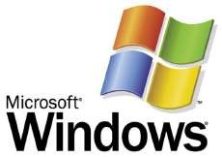

Windows and Mac are GUI’s
Microsoft Windows and Apple Macintosh operating systems are “graphical user interfaces” or GUI’s.
GUI is defined as: A picture used in place of a word or words to issue commands.

Slide 3
GUI – Standards
GUI interfaces have standards that are usually the same or similar in all systems and applications.
Standards apply to:
  Pointers and pointing devices
  Icons, desktops, windows and menus

Slide 4


Windows - GUI Pointers
GUI uses pictures, symbols, or icons rather than words to represent some object or function. For example:
A pointer or mouse pointer is a small arrow or other symbol that moves on the screen as you move a mouse.
  An I-Beam pointer is used by many desktop publishing systems and word processors to mark blocks of text and move the insertion point.

Slide 5
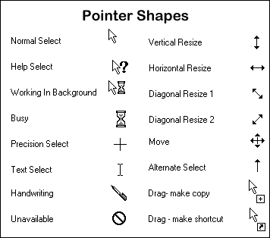
GUI – Cursors / Pointers
The term “cursor” typically is used to show where your typing will appear. Otherwise, the term “pointer” is the better choice.

Slide 6







Windows - GUI Icons
Icon - A small picture that represents a command, object, file, or window.
Point and click with a mouse to execute a command or convert the icon into a window.
Icons are moveable around the display screen, just like moving things around on your desk.

Slide 7






Object Icons & Shortcut Icons
You can create and use a shortcut icon to open any application quickly. You don’t have to use the Start Menu to access a program or document.
One type of icon is an object icon. It allows you to open applications and documents on your PC.

Slide 8
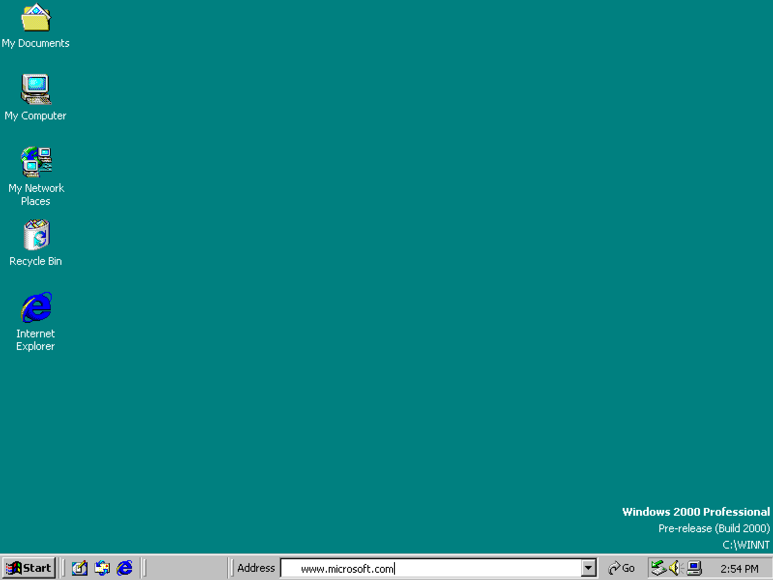
Windows - GUI Windows & Desktop
You can divide the screen into different areas.
In each window, you can run a different program or display a different file.
You can move windows around the display screen, and change their shape and size at will.

Slide 9
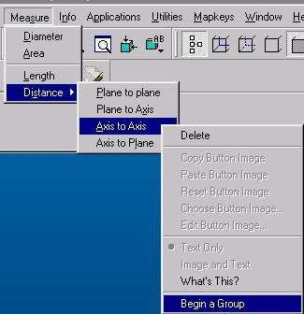
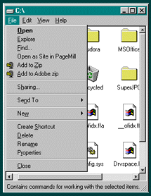
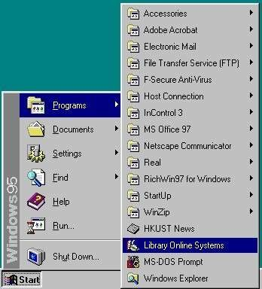
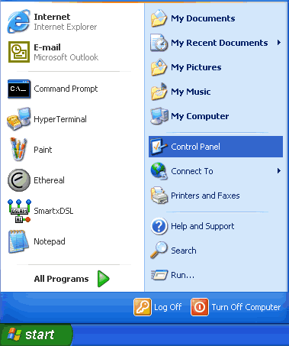
Windows - GUI Menus
Menu - is an on-screen list of options for using a program. It can also be a list of categories with many other menu options under it. Menus can "pop up" or "pull down."

Slide 10
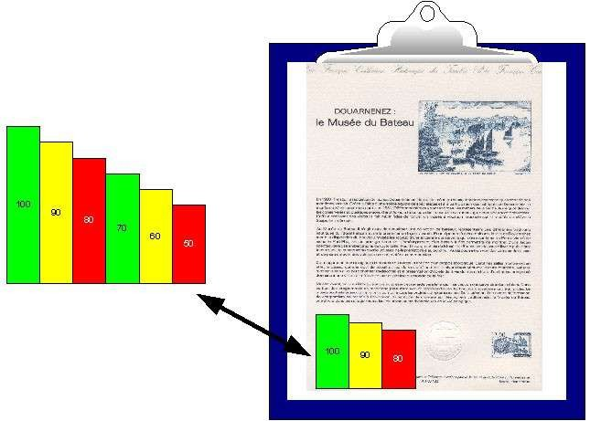
GUI – Share Data
Because the formats are well-defined, different programs that run under a common GUI can share data. This makes it possible, for example, to copy a graph created by a spreadsheet program into a document created by a word processor.

Slide 11
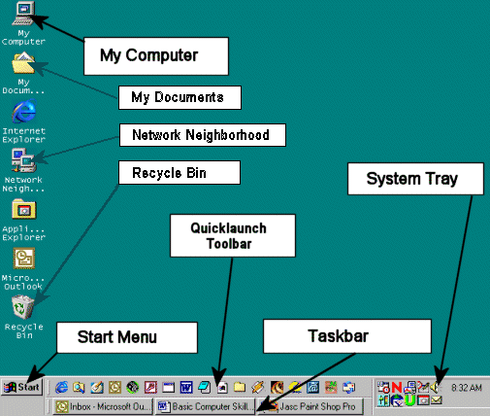
Parts of the Desktop

Slide 12
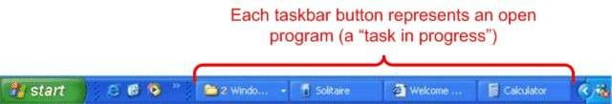
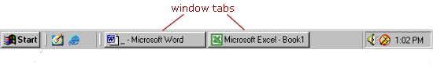
Windows - Taskbar
Taskbar – shows you the windows or programs that are currently open on the desktop. You can switch between windows by clicking on the applicable button.

Slide 13

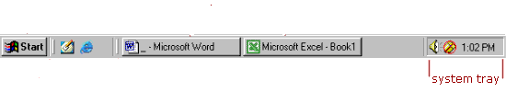
Windows – System Tray
System Tray – shows you running programs that were started automatically by the operating system, like anti-virus programs, the clock and volume controls. These programs are running in the background.

Slide 14
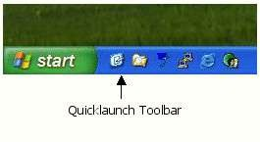
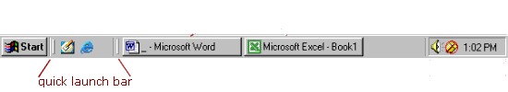
Windows - Quick Launch Toolbar
Quick Launch Toolbar – contains one-click buttons, or shortcuts, which open programs. You can customize this toolbar however you like.

Slide 15
Start Button
The start button allows you to easily access your computer programs or configure Windows. By default the start button is located at the bottom left side of the screen.

Slide 16
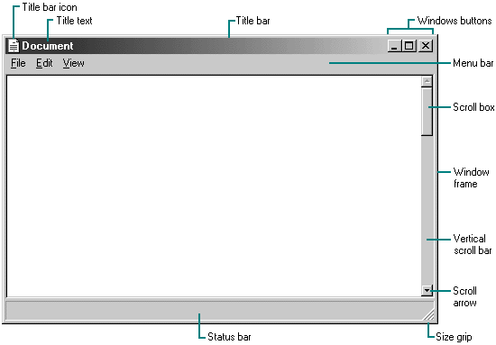
Parts of a Window

Slide 17

Title Bar
At the top edge of the window, inside its border, is the title bar which extends across the width of the window. It contains the title of the application or document.
A small icon in the far left corner of the title bar represents the object being viewed in the window.

Slide 18

Minimize, Maximize and Resize Windows
The title bar contains three little buttons in the upper right-corner of the window and are used to manage the window size or close it altogether.

Slide 19
Minimize - Maximize
The first button is the minimize button and it will hide the window. The window can be opened again by clicking its button on the taskbar.
The second button is maximize, which makes the window take up all the screen space. Clicking again turns the window back to the size it was. The double-box image is known as the restore button.

Slide 20
Close Window
The last button will close a window. If it is the last window of a certain type of program, it will exit or quit that program.

Slide 21
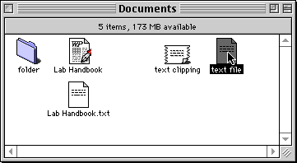
Move a Window
You can move a window to any location on the desktop by “clicking and dragging” the title bar with your mouse.
  This is also referred to as “drag and drop”.
You can also drag and drop icons to move the location of files or shortcuts.

Slide 22

Menu Bar
Menu bar - The horizontal bar near the top of a window that displays the names of menus from which you can access features and perform tasks for the current application.

Slide 23
Types of Menu Items
Arrow: another menu will cascade from it.
Three dots: a dialog box will open, containing choices for you to make.

Slide 24
Types of Menu Items
Checkmark: clicking this item will toggle the feature on or off.
If a keyboard shortcut is shown in the menu, you can use those keys to run the command without having to open the menu.

Slide 25
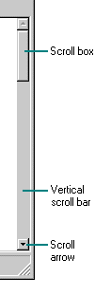
Scroll Bar
Scroll bar - the narrow rectangular bar at the far right of windows.
  Clicking on the up or down arrow enables you to move up and down through a document.
  A movable square indicates your location in the document.

Slide 26

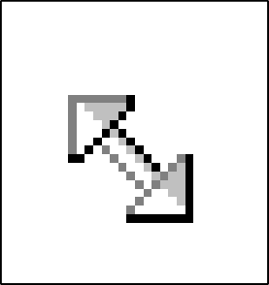
Windows Frame & Resizing
You can also resize a window by a click and drag move.
Put the mouse cursor on the edge of a window (that is not maximized) and when the pointer changes to a double arrow, click and drag for the new size. Some windows have a handle on them for resizing.

Slide 27

Status Bar
Status bar – is located at the bottom of a window and contains information about formatting options, errors, prompts, messages, or the status of an application.

Slide 28
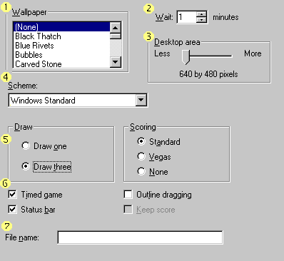
Dialog Boxes
List box
Spin control box
Slide
Drop-down list
Radio button
Checkbox
Text box

Slide 29
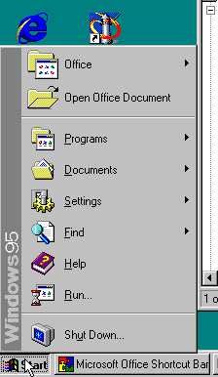
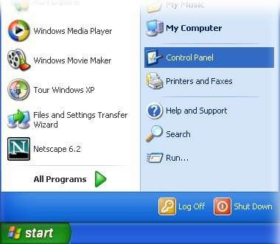
Windows – Start Menu
Start Menu – gives you access to all programs and functions on your PC, including “help” files and “search” capabilities.

Slide 30
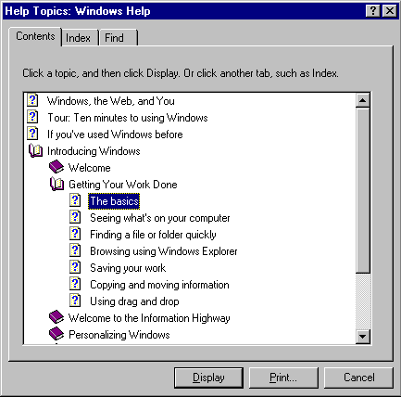
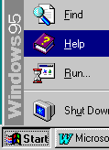
Windows HELP
Access Windows HELP through the Start menu.
Windows 95 HELP menu

Slide 31
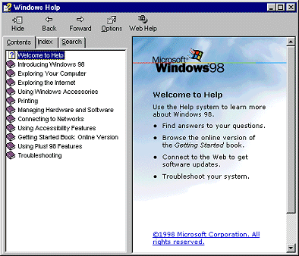
Windows HELP
Windows 98 HELP menu

Slide 32
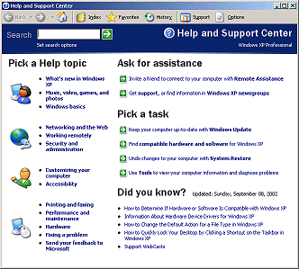
Windows HELP
Windows XP HELP menu

Slide 33
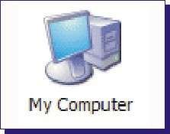
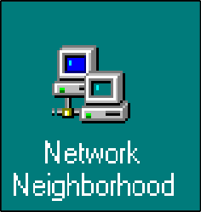


Windows System Programs
Windows has a number of internal programs as part of the operating system that help keep you organized and your PC healthy.
Here are a few:

Slide 34
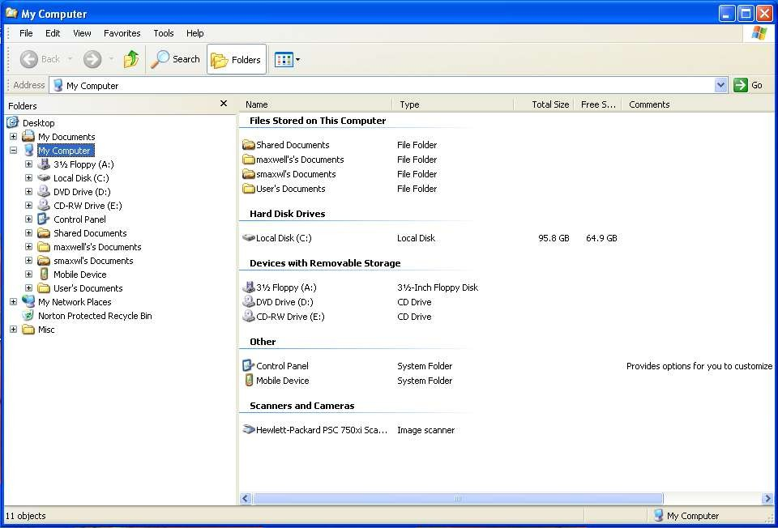
Windows - My Computer
Also known as
the Windows
Explorer
My Computer – inside this icon you can find every folder and file that your PC has access to.

Slide 35


Slide 36

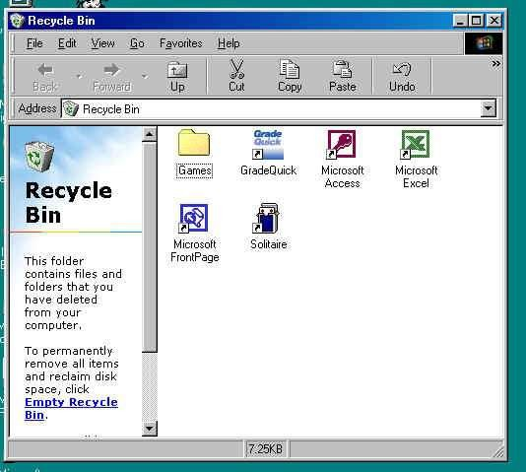
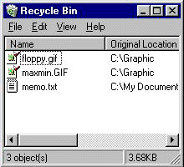
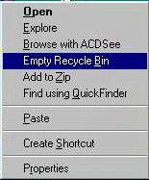
Windows – Recycle Bin
Recycle Bin – Deleted files and folders go here first, where they wait to be permanently deleted by you, or by rules that you set up. This is a temporary storage area on your hard drive.

Slide 37

Windows – My Docs
My Documents – a place to store the documents and files you create. Clicking on this opens an explorer window displaying the detail.
  It’s wise to keep the files you create separate from the program files, so when you backup your data, it’s all located in one location. You can then backup just this area of your storage.

Slide 38
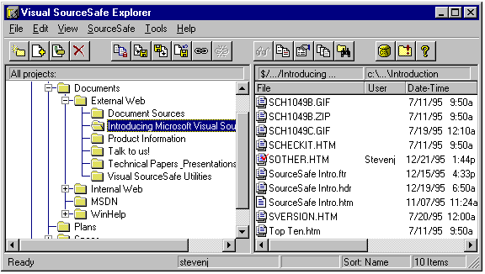
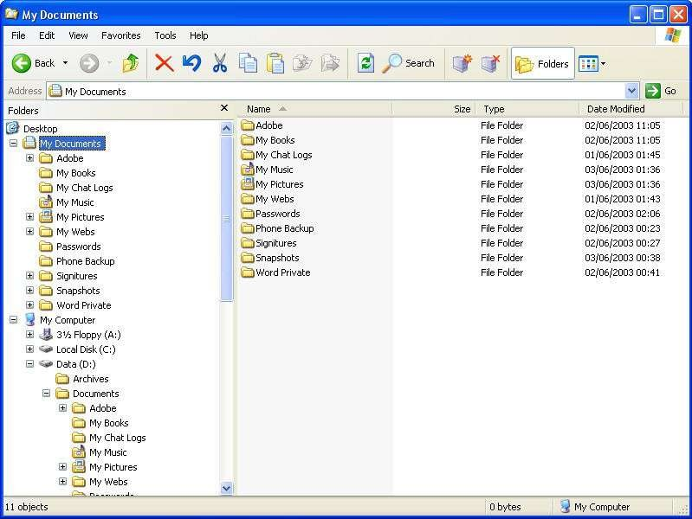
My Documents – Explorer Window

Slide 39

Windows – Network Neighborhood
Network Neighborhood – serves as a window into the network resources you have on your PC.
  If you are connected to a network you will see all the other PC’s linked to your network and you can share files, printers or other hardware.

Slide 40
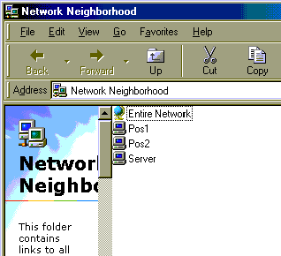
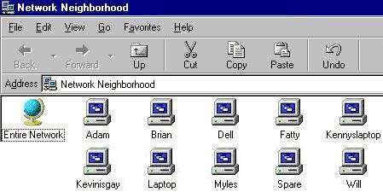
Network Neighborhood

Slide 41
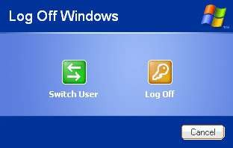
Logoff
If your have multiple users on a PC with separate “profiles” or user logons, use the logoff process to close out of your profile or to switch users.

Slide 42
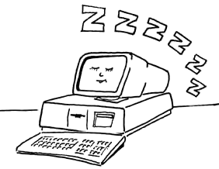
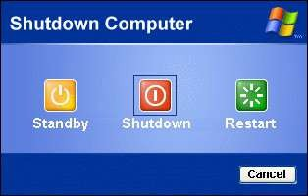
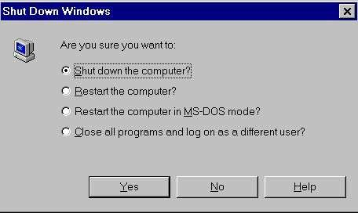
Shutdown Windows
There is a “graceful” way of shutting down your PC that will save your program settings and files.
  This shutdown process basically puts the operating system to bed.

Slide 43
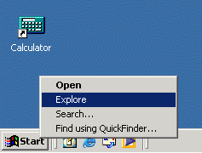
Which Explorer?
Tip: Don't confuse Windows Explorer with Internet Explorer.
Windows Explorer is the program that lets you explore things "inside" your own computer.
Internet Explorer lets you explore things "outside" your computer -- namely things on the Internet.

