Slide 1
Basic Excel Formulas & Functions
Ravindra Singh
Asst.Prof.
Computer Department
Durga College
SUM
COUNT
AVERAGE
MIN Excel
MAX Excel
LEN Excel

Slide 2
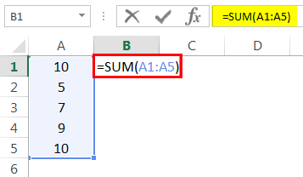
SUM Function
This basic Excel formula is used to get the sum of the value in one or more cells or ranges.The SUM function returns the sum of values supplied. These values can be numbers, cell references, ranges, arrays, and constants, in any combination. SUM can handle up to 255 individual arguments.
=SUM(value1, value2….)
Result = 41 (See Image below)

Slide 3
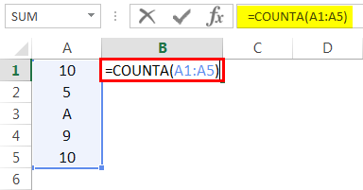
COUNT Function
The COUNT Function[ is an Excel Statistical function. This formula counts the value in one or more cells This function helps count the number of cells that contain a number, as well as the number of arguments that contain numbers. It will also count numbers in any given array. It was introduced in Excel in 2000.
=COUNT(value1, value2….)
Result = 5 (This will Include Cell A3 since this formula calculates both text and numeric value. See Image below).

Slide 4
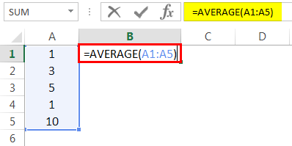
AVERAGE Function
The Excel AVERAGE function calculates the average (arithmetic mean) of supplied numbers. AVERAGE can handle up to 255 individual arguments, which can include numbers, cell references, ranges, arrays, and constants.
= AVERAGE (value1, value2….)
Result = 4 (See image below)

Slide 5
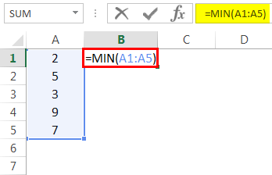
MIN Function
The MIN function checks your data range and returns the smallest value in the set. Its syntax is the following:
MIN(value1, value2….)
number1, [number2], … is the series of values from where you want to get a minimum. Number1 is required while [number2] and the following are optional.
There are up to 255 arguments allowed in one function. The arguments can be numbers, cells, arrays of references, and ranges. However, arguments like logical values, text, empty cells are ignored.
MIN(value1, value2….)
Result = 2 (See Image below)

Slide 6
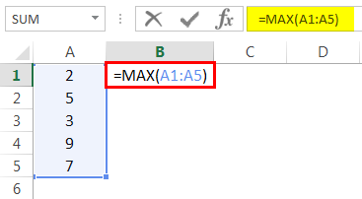
MAX Function
The MAX Function is categorized under Excel Statistical functions. MAX will return the largest value in a given list of arguments. From a given set of numeric values, it will return the highest value. Unlike MAXA function, the MAX function will count numbers but ignore empty cells, text, the logical values TRUE and FALSE, and text values.
MAX(value1, value2….)
Result = 9 (See Image below)

Slide 7
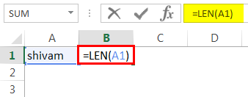
LEN Function
The Excel LEN function returns the length of a given text string as the number of characters. LEN will also count characters in numbers, but number formatting is not included.
=LEN(text)
Cell A1 value is Shivam, which has a 6-character length.
So, the result would be 6 (See image below).

