Slide 1
SYADVADA…
-By Dr. Ranjana Sharma
Head Department of Philosophy
Durga Mahavidyalaya, Raipur (C.G.)

Slide 2
Theory of Judgement…
Syadvada is also called as Jain theory of judgement.
According to this theory “every judgement is relative”.
It is based on Anekantvad of Jainism.
Anekantvad means ‘Anant Dharmakam Vastu’.
It means every object has innumberable characteristics.

Slide 3
How every objects has innumerable characters[Anant Dharmakam Vastu]
Every object has positive and negative characters.
Positive character for example, of a man is his size, his colour,shape,weight,family,race,nationality,education, employment,place of birth etc.
Negative character of a man is the man consists of what he is not for example he is not Indian, he is not employed, he is not a poet etc.
To know him completely [fully] we should know his positive and negative characteristics both, as he is Indian, not Chinise, he is employed, not unemployed, he is an honest, not dishonest etc.

Slide 4
As the negative characters of the man consists in his distinctions from all other objects in the universe, negative characters are far greater than positive characters.
Positive and negative characters make an object of unlimited characters.
If we take the element of time [Past, Present, Future]it becomes characters with infinite characters[Anant, Dharmakam, Vastu].

Slide 5
Objects have many characters
Only an omniscient being [Kewali] can obtain [through Kevalya gyan] an immediate knowledge of an object with all its innumerable characters.
But imperfect beings look at objects from one particular point of view at a time and have consequently the knowledge of only one aspect or character of the thing.
Particular knowledge about one of the innumerable aspects [characters]of an object is called by Jain ‘Naya’.
Judgement [pasamarsh] based on such particular knowledge is also called a ‘Naya’.

Slide 6
Every Judgment Is Relative
Every judgment that we pass in daily life about any object is therefore, true only in reference to the standpoint occupied and the aspect of the object considered.
Generally we forget this limitation and regard our judgments as unconditionally true.
This is the main reason of quarrel and disagreement.

Slide 7
To clear their view they describe the story of blind men and elephant.
The story of the blind men who formed their ideas of an elephant by touching its legs, ears, tail and trunk respectively and thus came to quarrel about the real shape of elephant. They quarreled because each thought that his knowledge was the only true and complete knowledge and should be accepted unconditionally.
The quarrel was over as soon as each of them realized that his knowledge was only of one of the many parts of the elephant.

Slide 8
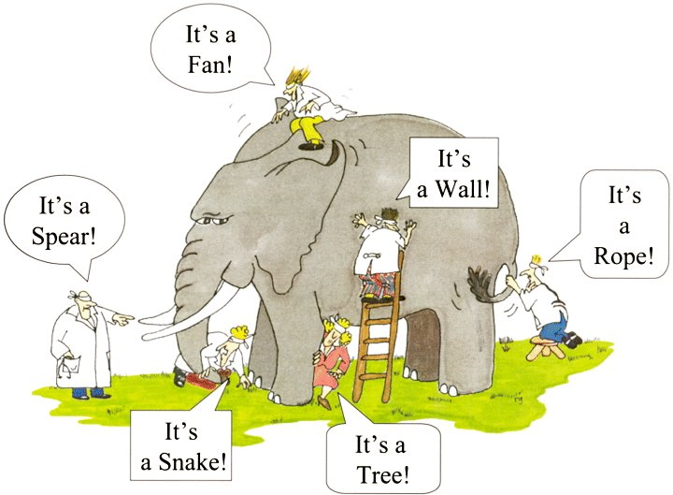

Slide 9
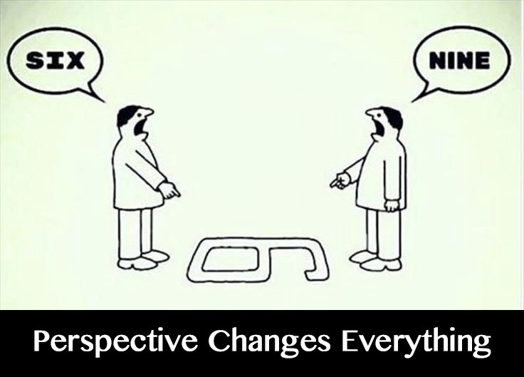
Another example could be

Slide 10
Every Judgment should be qualified by “Syat”
Syat means the judgment is true in some respect [or somehow].
The limitation of the judgment and the possibility of other alternative judgments from other points of view may be always clearly borne in mind.
So it is suggested for example instead of a judgment like ‘The elephant is like a pillar ‘,it should be said ,’somehow [i.e.in respect of its legs, the elephant is like a pillar.
In the same way , we should not say ‘The jug exists’ but should rather say ‘Syat[somehow] the jug exists.’
‘Syat’reminds us that the judgment is true only with regard to the many conditions of space, time, quality etc.

Slide 11
Seven Forms Of Judgment
Ordinarily , there are two kinds of judgment affirmative and negative.
The Jains distinguish seven kind of judgment including these two-
1.Syat asti.
2. Syat nasti.
3. Syat asti cha nasti cha.
4. Syat avaktavyam.
5.Syat asti cha avaktavyam cha.
6.Syat nasti cha avaktavyam cha.
7.Syat asti cha nast cha avaktavyam cha.

Slide 12
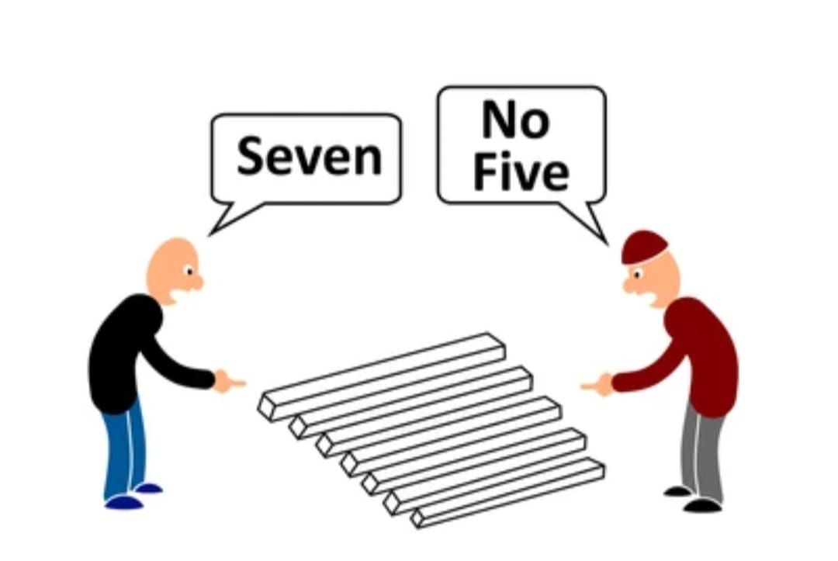
Jain’s Theory Is Not Sceptic
It is not the uncertainty of judgment. It has conditional or relative character which is expressed by ‘Syat’.

